Slide 1
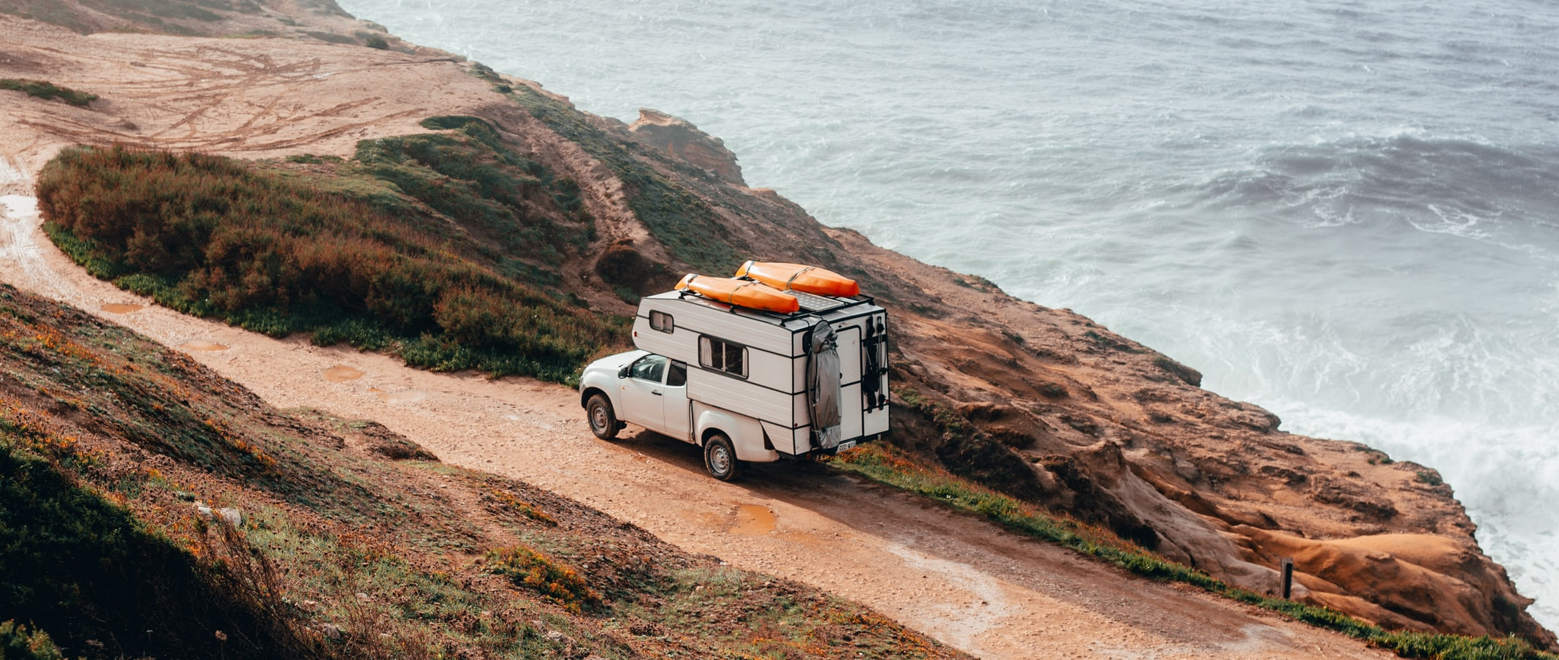



MONITORING SENTIMENT FOR DOMESTIC AND INTRA-EUROPEAN TRAVEL
WAVE 6 | 04/21
Co-funded by the European Union

Slide 2
WAVE 6
RESEARCH HIGHLIGHTS
This report monitors sentiment and short-term intentions for domestic and intra-regional travel within Europe and is the sixth wave of market research, initiated in September 2020. Responses are collected from European citizens from 10 high-volume source markets in light of the COVID-19 crisis.
Europeans’ desire for travel climbs to its highest level since the survey begun, with 56% of total respondents planning to take a trip by the end of August. 22% of all surveyed Europeans intend to travel between May and June 2021, while an additional 36% are in favor of taking trip later in the summer.
29% of ‘early-bird’ travellers¹ target the May and June period, while an additional 46% favour July and August for their next trip. As for destination choice, 49% aim to travel to another European country and 36% to remain within their domestic borders.
Vacations remain the predominant travel motivation for Europeans: 66% of early-bird travellers will travel for leisure - up from the 56% pre-pandemic benchmark², while visiting friends and relatives is the main purpose for 19% of travellers.
2
¹ “Early-bird” travellers refers to survey respondents that are most likely to travel in the next 6 months/ have short term travel plans
² UNWTO, 2019

Slide 3
WAVE 6
RESEARCH HIGHLIGHTS
The impact of COVID-19 vaccines on travel sentiment is fairly positive; 48% of all surveyed Europeans feel much more confident about planning trips in the next 6 months as a result of the vaccine rollout. 31% have neutral feelings, while 21% of respondents are still very sceptical.
Interest in holidays by the sea remains strong; 34% of early-bird travellers favour this kind of trip. A preference for nature and the outdoors is stated by 15% of respondents and is particularly strong among those from central European markets.
Over half of early-bird travellers (52%) show a willingness to make their next trip by plane, though in Britain, there appears to have been a falling off in air travel confidence, with an 11% decrease in this preference. Car travel remains the second most popular choice for 36% of Europeans with short-term travel plans.
3

Slide 4
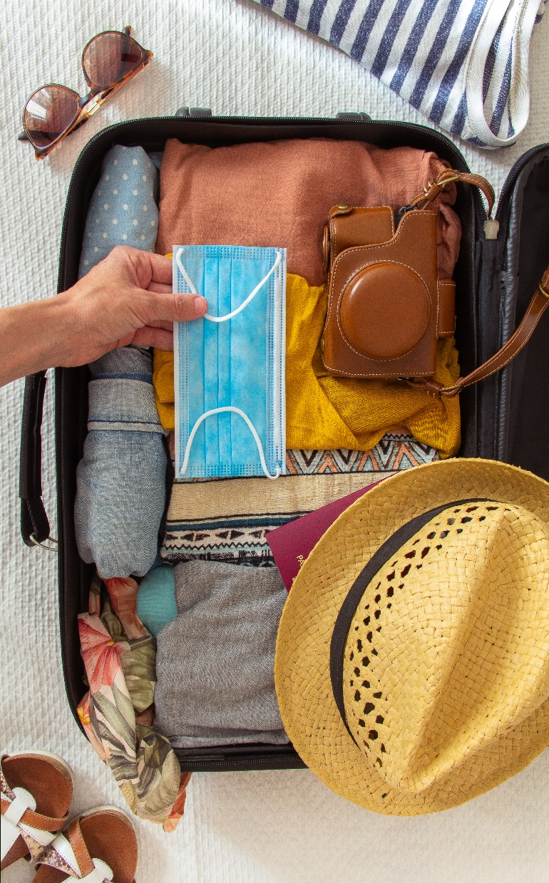
WAVE 6 RESEARCH HIGHLIGHTS
Despite the efforts made by EU countries to bolster tourism in face of the pandemic, Europeans are still experiencing challenges in following their original travel plans: only 9% of all respondents have not modified plans for their upcoming holidays.
When it comes to personal health, air travel is mentioned by 17% of all Europeans surveyed as the most worrisome part of the trip, followed by visiting bars and restaurants (13%).
While quarantine measures are the leading concern for early-bird travellers (16%), there is growing anxiety (11%) regarding limitations on activities available and “things to do” at the destination.
4

Slide 5
WAVE 6
INSIGHTS ON TRAVELLERS’ ONLINE SENTIMENT
The report is also complemented by insights on travellers’ online sentiment for major European destinations for the period of January 2021 compared to January 2020. ¹
36% of all travel social media mentions are made by the 35-44 age group – double the number of those made by the hyper-connected young Millennials age group (aged 25-35).
In January 2021, the Tourism Product Index² - measuring tourists΄ satisfaction with the offering of European destinations - was 60%, representing a 7% decrease compared to January 2020 and a small 4% increase from December 2020. This slight improvement could indicate that both tourists and destinations are slowly adapting to tourism in the COVID-19 era.
The Hotel Satisfaction Index² during January 2021 was 64% - the same as in January 2020 and only slightly below its December 2020 level of 66%. Also in this case, stability indicates an adjustment to the 'new normal'.
5
¹ Benchmark report for major European destinations; January 2021 compared to January 2020 (Mabrian Technologies, April 2021)
² Tourist Product/ Hotel Satisfaction Indexes, measure satisfaction levels of visitors to a destination with its offering (arts & culture, food & cuisine, sunbathing, etc) & accommodation respectively. For more info on methodology and scoring system please refer to slide 49

Slide 6

WAVE 6
RECOMMENDATIONS FOR DESTINATIONS
As concerns among travellers regarding the destination experience grow, NTBs and DMOs¹ should communicate clearly which attractions are currently open and which restrictions/ rules apply to visitors. Consistent and transparent messaging will be the key to managing travellers’ expectations and re-building confidence.
Developing and communicating strict COVID-19 protocols for bars and restaurants is critical. Campaigns employing a funnier and engaging approach to COVID-19 measures would boost consumers’ confidence and address health anxieties to visit such places.
To accommodate road-trippers and nature seekers, destinations could offer special itineraries, off-the-beaten-track experiences and outdoor family fun stops. A good example of engaging content would be playlists of local music to accompany car rides, making the experience more immersive.
Responsible travel is at the forefront of restarting tourism. Destinations should undertake initiatives such as brand story telling cultivating a "sense of care", partnering with environmental NGOs and including guests in local community events and activities.
6
¹ NTBs: National Tourism Boards – DMOs: Destination Marketing Organizations
*Example: https://mamashelter.com/covid-19/

Slide 7

WAVE 6
RECOMMENDATIONS FOR BUSINESSES
After a long wait, businesses should capitalise on the positive travel sentiment and customer confidence for the spring-summer periods. ‘Buy now - save later’ deals, free upgrades, lead-nurturing strategies and re-marketing campaigns will motivate hesitant customers.
As many sun and sea destinations announce opening dates, independent hotels and resorts could strengthen staff training in adjusting to the new circumstances, further developing resilience thinking, implementing health and safety protocols and using brand values to provide worry-free vacations for their guests.
For 3 in 4 Europeans, travel is the time to get together with their family/partner. Therefore, tourism brands can market themselves as the ideal setting for families and partners to share quality time and extraordinary experiences.
With travel corridors being agreed between countries and direct bookings on the rise, service providers - accommodation, airlines and car-rental businesses - could collaborate on discount “fly/drive and stay” packages and promote them directly to niche audiences.
7

Slide 8
CONTENTS
01. | 02. | 03. | 04.
TRAVEL | TRIP | TRAVEL | METHODOLOGICAL
INTENTIONS | PLANNING | CONCERNS | ANNEX
P. 10 | P. 32 | P. 39 | P. 47

Slide 9
How to read
Wave 6
Dates on the graphs refer to the following data collection periods for each research wave:
To present Wave 6 timings in which respondents are most likely to take their next trip, the following time periods should be used as a reference:
This month; February 2021.
In 1-2 months; March – April 2021.
In 3-4 months; May – June 2021.
In 5-6 months; July – August 2021.
To present data and insights, the following distinct groups have been analysed:
Total respondents; 5,837
Respondents with short-term travel plans/ most likely to travel in the next 6 months (”early-bird travellers”); 3,246
Respondents selecting outbound European destinations; 4,122
Only significant changes between current and previous waves are shown; Significant changes refer to >2.5% for the total sample and >5% for the smaller samples, in absolute numbers. To indicate these changes, the following symbols were used:
Increasing , decreasing
Numbers next to the arrows reflect the percentage of change in the share of respondents selecting a specific response between current and previous waves
When mention of new COVID-19 cases is made, it refers to the data collection period.
All data and insights refer to domestic and intra-European travel, unless otherwise stated.
 | Wave 1 | Wave 2 | Wave 3 | Wave 4 | Wave 5 | Wave 6
Surveys dates | 27 Aug – 15 Sep ‘20 | 21 Sep – 9 Oct ’20 | 19 Oct – 6 Nov ’20 | 20 Nov – 3 Dec ’20 | 18 Dec ‘20 – 7 Jan ‘21 | 5-19 Feb ‘21
9

Slide 10

TRAVEL INTENTIONS
01

Slide 11






Travel sentiment climbs to its highest level since September 2020: 56% of Europeans intend to travel by the end of August 2021
Top 5 markets which are most likely
to travel in the next 6 months
Intention to travel in the next 6 months
Poland
79.2%
Germany
56.3%
10%
Italy
63.7%
5%
Netherlands
Austria
15%
55.8%
56.6%
11
Q7.Do you plan to take an overnight trip domestically or within Europe in the next 6 months, either for personal or professional purposes?
No. of respondents: 5,837

Slide 12
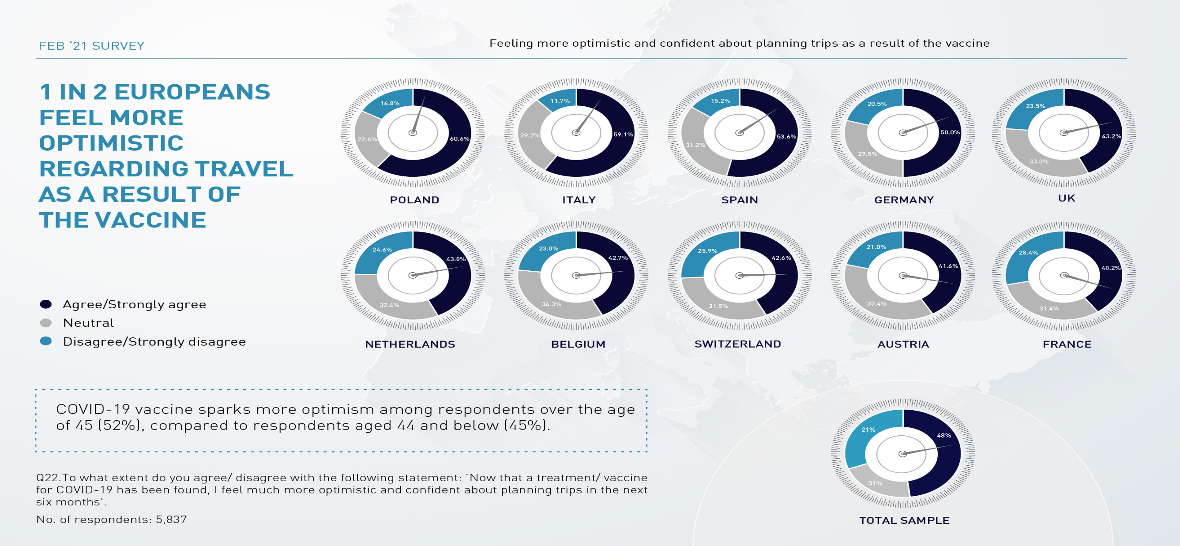
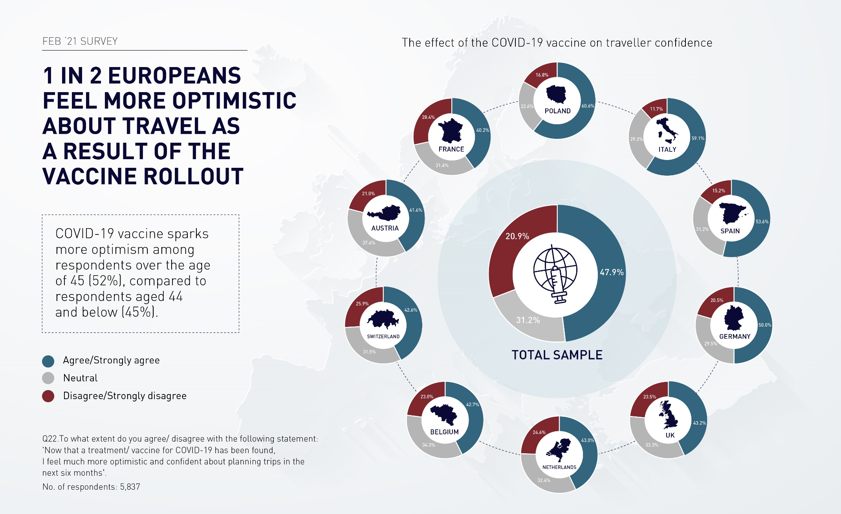
12

Slide 13





Interest in travel by summer's end surges among 45 to 55-year-olds,
while Gen Z (18-24) hesitancy persists
18-24
Vaccine rollout brings travel confidence in only 28% of Gen Z respondents as opposed to 36% among those over 35.
Intention to travel in the next 6 months by age group
25-34
35-44
45-54
≥55
Feb ‘21 survey
13
Q7.Do you plan to take an overnight trip domestically or within Europe in the next 6 months, either for personal or professional purposes?
No. of respondents: 5,837

Slide 14
Despite rise in interest for sun and beach holidays, urban destinations
maintain a steady fascination among European travellers
Respondents most likely to travel in the next 6 months, per type of traveller
Sun & beach lovers
Bleisure travellers
Business travellers
Explorers of cultural identity & roots
Immersive explorers
City life enthusiasts
Gastronomy lovers
14
Q7.Do you plan to take an overnight trip domestically or within Europe in the next 6 months, either for personal or professional purposes?
No. of respondents: 3,246

Slide 15
The overall sample displays increasing certainty about trip timing,
with many eyeing July-August
When will Europeans travel next?
Total sample vs. early-bird travellers
12%
17%
No. of respondents: 5,837
No. of respondents: 3,246
15
Q9.When are you most likely to go on your next trip either in your country or within Europe?

Slide 16
International travel within Europe remains respondents' leading choice,
a trend that is even stronger among “early-bird” travellers
Where will Europeans travel within the next 6 months?
Total sample vs. early-bird travellers
No. of respondents: 5,837
No. of respondents: 3,246
16
Q10.Where do you plan to travel in the next 6 months?

Slide 17
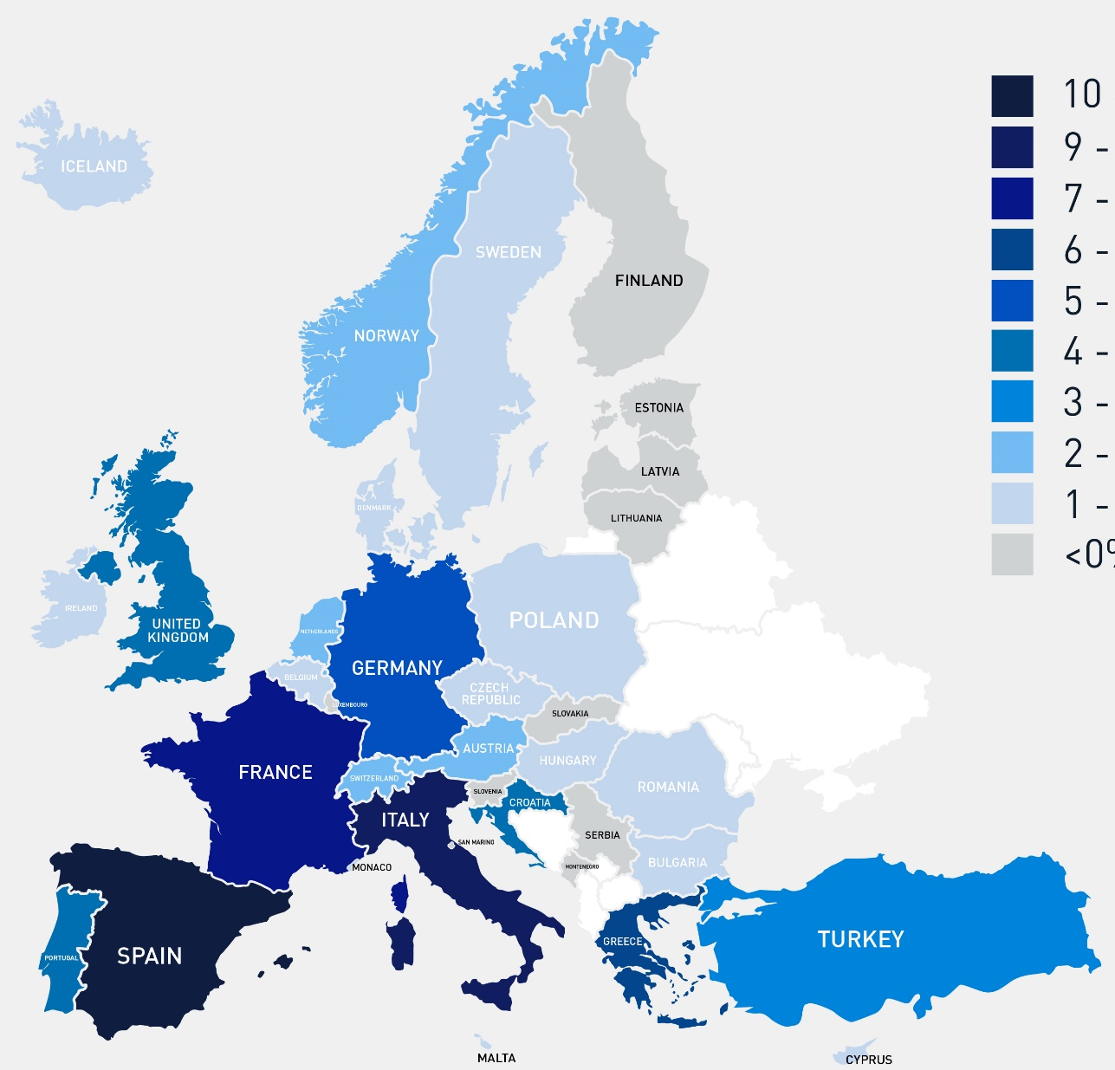

Feb ‘21 survey
PREFERRED COUNTRIES FOR THE NEXT ΕUROPEAN TRIP
Italy narrows the gap with Spain while top 5 destinations hold their positions
TOP 10 COUNTRIES
Spain
Italy
France
Greece
Germany
Portugal
United Kingdom
Croatia
Turkey
Netherlands
10.4%
9.0%
7.0%
6.2%
5.2%
4.7%
4.2%
4.0%
3.5%
2.9%
Please use this map as a reference only
* No significant changes between waves were recorded for this question
No. of respondents: 4,122
17
Q11. To which country(ies) do you plan to travel next?

Slide 18






Leisure is the predominant travel motivation for the upcoming spring and summer
Purpose of travel for respondents
most likely to travel in the next 6 months
Top 3 markets to resume
leisure travel
Top 3 markets to resume
business travel
Poland
Germany
15%
11.1%
74.7%
Italy
Spain
72.8%
10.8%
Belgium
Netherlands
68.3%
10.4%
18
Q8.For what reason are you most likely to travel within Europe next?
No. of respondents: 3,246

Slide 19

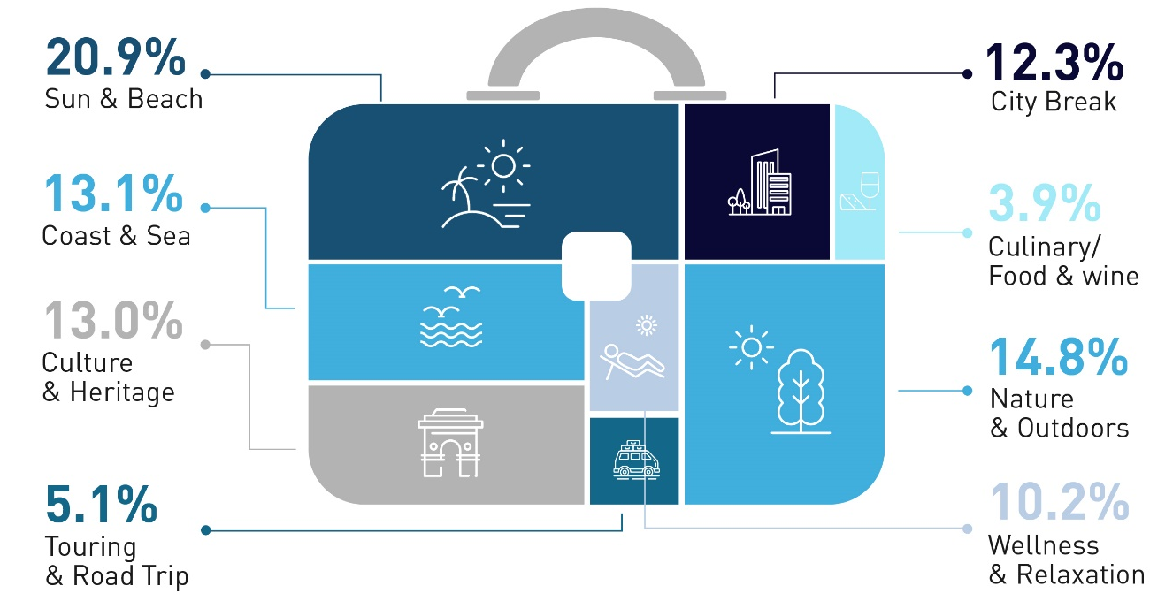
Over 1 in 3 Europeans with upcoming travel plans will head for the sea, while scenic natural settings are in demand for 15% of respondents
Preferred type of leisure trip for respondents most likely to travel in the next 6 months
72% of respondents planning a culture and heritage trip see health & safety protocols in a positive light, vs. 62% of those planning to travel for nature and outdoors
Feb ‘21 survey
19
* No significant changes between waves were recorded for this question
Q17.What type of leisure trip within Europe are you most likely to undertake next?
No. of respondents: 3,246

Slide 20



Holiday preferences remain unchanged except for
a 61% rise in sun and beach interest among the Swiss
Feb ‘21 survey
Sun & Beach
Coast & Sea
Cruising
61%
How to read: Percentages indicate the share of respondents from each country interested in each type of leisure trip; i.e. 30.0% of respondents from UK are most likely to undertake a sun and beach trip
20
Q17.What type of leisure trip within Europe are you most likely to undertake next?
No. of respondents: 5,837

Slide 21



The great outdoors holds a particular appeal for Central Europeans and residents of Benelux countries
Feb ‘21 survey
City Break
Nature & Outdoors
Culture & Heritage
18%
14%
How to read: Percentages indicate the share of respondents from each country interested in each type of leisure trip; i.e. 30.2% of respondents from Spain are most likely to undertake a city break trip
21
Q17.What type of leisure trip within Europe are you most likely to undertake next?
No. of respondents: 5,837

Slide 22

GERMANY
More than 1 in 2 Germans are optimistic about travelling in the next 6 months, with a particular emphasis on July and August trips
Willingness to travel in the next 6 months
When will Germans travel?
Where will Germans travel within the next 6 months?
23%
22%
10%
23%
This month
In 1-2 months
In 3-4 months
Aug- Sep '20
survey
Sep- Oct '20
survey
Oct- Nov '20
survey
In 5-6 months
I don’t know yet
Nov- Dec '20
survey
Dec ’20- Jan ‘21
survey
Feb ‘21
survey
For specific dates please refer to slide 9
Q7.Do you plan to take an overnight trip domestically or within Europe in the next 6 months, either for personal or professional purposes?
Q9.When are you most likely to go on your next trip either in your country or within Europe?
Q10.Where do you plan to travel in the next 6 months?
22
No. of respondents: 750

Slide 23
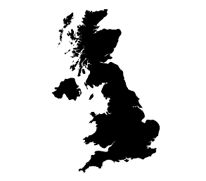
UNITED KINGDOM
Britons’ sentiment greatly deteriorates in light of UK government advice against non-essential international travel*
Willingness to travel in the next 6 months
When will Britons travel?
Where will Britons travel within the next 6 months?
17%
10%
This month
In 1-2 months
In 3-4 months
Aug- Sep '20
survey
Sep- Oct '20
survey
Oct- Nov '20
survey
In 5-6 months
I don’t know yet
Nov- Dec '20
survey
Dec ’20- Jan ‘21
survey
Feb ‘21
survey
For specific dates please refer to slide 9
Q7.Do you plan to take an overnight trip domestically or within Europe in the next 6 months, either for personal or professional purposes?
Q9.When are you most likely to go on your next trip either in your country or within Europe?
Q10.Where do you plan to travel in the next 6 months?
23
No. of respondents: 750
*The survey was conducted before the roadmap for lifting UK lockdown was announced

Slide 24
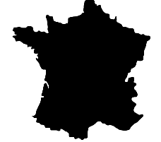
FRANCE
The French maintain a stable travel sentiment
with 39% looking at July and August for their next vacations
Willingness to travel in the next 6 months
When will French travel?
Where will French travel within the next 6 months?
This month
In 1-2 months
In 3-4 months
Aug- Sep '20
survey
Sep- Oct '20
survey
Oct- Nov '20
survey
In 5-6 months
I don’t know yet
Nov- Dec '20
survey
Dec ’20- Jan ‘21
survey
Feb ‘21
survey
For specific dates please refer to slide 9
Q7.Do you plan to take an overnight trip domestically or within Europe in the next 6 months, either for personal or professional purposes?
Q9.When are you most likely to go on your next trip either in your country or within Europe?
Q10.Where do you plan to travel in the next 6 months?
24
No. of respondents: 691

Slide 25

NETHERLANDS
The Dutch are now more interested in taking a trip during the next 6 months (+15%), with destinations abroad* becoming more appealing (+7%)
Willingness to travel in the next 6 months
When will Dutch travel?
Where will Dutch travel within the next 6 months?
31%
22%
15%
43%
This month
In 1-2 months
In 3-4 months
Aug- Sep '20
survey
Sep- Oct '20
survey
Oct- Nov '20
survey
In 5-6 months
I don’t know yet
Nov- Dec '20
survey
Dec ’20- Jan ‘21
survey
Feb ‘21
survey
For specific dates please refer to slide 9
Q7.Do you plan to take an overnight trip domestically or within Europe in the next 6 months, either for personal or professional purposes?
Q9.When are you most likely to go on your next trip either in your country or within Europe?
Q10.Where do you plan to travel in the next 6 months?
25
No. of respondents: 500
*Refers to other European countries and countries outside Europe.

Slide 26
ITALY
2 in 5 Italians plan to take a trip around mid to late summer,
favouring domestic destinations
Willingness to travel in the next 6 months
When will Italians travel?
Where will Italians travel within the next 6 months?
20%
This month
In 1-2 months
In 3-4 months
Aug- Sep '20
survey
Sep- Oct '20
survey
Oct- Nov '20
survey
In 5-6 months
I don’t know yet
Nov- Dec '20
survey
Dec ’20- Jan ‘21
survey
Feb ‘21
survey
For specific dates please refer to slide 9
Q7.Do you plan to take an overnight trip domestically or within Europe in the next 6 months, either for personal or professional purposes?
Q9.When are you most likely to go on your next trip either in your country or within Europe?
Q10.Where do you plan to travel in the next 6 months?
26
No. of respondents: 750

Slide 27

BELGIUM
Belgian respondents show preference for intra-European travel
with July and August (+20%) perceived as the most feasible time for trips
Willingness to travel in the next 6 months
When will Belgians travel?
Where will Belgians travel within the next 6 months?
20%
This month
In 1-2 months
In 3-4 months
Aug- Sep '20
survey
Sep- Oct '20
survey
Oct- Nov '20
survey
In 5-6 months
I don’t know yet
Nov- Dec '20
survey
Dec ’20- Jan ‘21
survey
Feb ‘21
survey
For specific dates please refer to slide 9
Q7.Do you plan to take an overnight trip domestically or within Europe in the next 6 months, either for personal or professional purposes?
Q9.When are you most likely to go on your next trip either in your country or within Europe?
Q10.Where do you plan to travel in the next 6 months?
27
No. of respondents: 499

Slide 28

SWITZERLAND
The Swiss are starting to pinpoint exact timing of their next trip,
reporting a 72% surge in their travel plans for the period May-June 2021
Willingness to travel in the next 6 months
When will Swiss travel?
Where will Swiss travel within the next 6 months?
21%
11%
72%
39%
This month
In 1-2 months
In 3-4 months
Aug- Sep '20
survey
Sep- Oct '20
survey
Oct- Nov '20
survey
In 5-6 months
I don’t know yet
Nov- Dec '20
survey
Dec ’20- Jan ‘21
survey
Feb ‘21
survey
For specific dates please refer to slide 9
Q7.Do you plan to take an overnight trip domestically or within Europe in the next 6 months, either for personal or professional purposes?
Q9.When are you most likely to go on your next trip either in your country or within Europe?
Q10.Where do you plan to travel in the next 6 months?
28
No. of respondents: 397

Slide 29
SPAIN
Spanish respondents display the second strongest desire for domestic travel
from all surveyed markets, without committing to an exact date
Willingness to travel in the next 6 months
When will Spaniards travel?
Where will Spaniards travel within the next 6 months?
12%
This month
In 1-2 months
In 3-4 months
Aug- Sep '20
survey
Sep- Oct '20
survey
Oct- Nov '20
survey
In 5-6 months
I don’t know yet
Nov- Dec '20
survey
Dec ’20- Jan ‘21
survey
Feb ‘21
survey
For specific dates please refer to slide 9
Q7.Do you plan to take an overnight trip domestically or within Europe in the next 6 months, either for personal or professional purposes?
Q9.When are you most likely to go on your next trip either in your country or within Europe?
Q10.Where do you plan to travel in the next 6 months?
29
No. of respondents: 500

Slide 30
POLAND
Eager to be on the move, more Poles (+61%) are targeting May and June and are primarily interested in visiting foreign destinations
Willingness to travel in the next 6 months
When will Poles travel?
Where will Poles travel within the next 6 months?
24%
61%
This month
In 1-2 months
In 3-4 months
Aug- Sep '20
survey
Sep- Oct '20
survey
Oct- Nov '20
survey
In 5-6 months
I don’t know yet
Nov- Dec '20
survey
Dec ’20- Jan ‘21
survey
Feb ‘21
survey
For specific dates please refer to slide 9
Q7.Do you plan to take an overnight trip domestically or within Europe in the next 6 months, either for personal or professional purposes?
Q9.When are you most likely to go on your next trip either in your country or within Europe?
Q10.Where do you plan to travel in the next 6 months?
30
No. of respondents: 500

Slide 31

AUSTRIA
Austrians are now keener on travel than at any time in the last 6 months,
with a 48% rise in planned trips for May and June
Willingness to travel in the next 6 months
When will Austrians travel?
Where will Austrians travel within the next 6 months?
14%
48%
This month
In 1-2 months
In 3-4 months
Aug- Sep '20
survey
Sep- Oct '20
survey
Oct- Nov '20
survey
In 5-6 months
I don’t know yet
Nov- Dec '20
survey
Dec ’20- Jan ‘21
survey
Feb ‘21
survey
For specific dates please refer to slide 9
Q7.Do you plan to take an overnight trip domestically or within Europe in the next 6 months, either for personal or professional purposes?
Q9.When are you most likely to go on your next trip either in your country or within Europe?
Q10.Where do you plan to travel in the next 6 months?
31
No. of respondents: 500

Slide 32

TRIP PLANNING
02

Slide 33






3 in 4 Europeans will use their next trip for spending time with their family or partner
Feb ‘21
survey
Preferred travel companion for respondents most likely to travel in the next 6 months
Aug- Sep '20
survey
Sep- Oct '20
survey
Oct- Nov '20
survey
Nov- Dec '20
survey
Dec ’20 - Jan ‘21
survey
With my family
By myself
Families favour travelling by car (37%) while those travelling solo (18%) or in groups of friends (13%) say they would take a train
Other
With my partner
With friends
* No significant changes between waves were recorded for this question
33
Q16.With whom are you most likely to travel during your next trip within Europe?
No. of respondents: 3,246

Slide 34
Europeans tap review websites and destinations’ digital touchpoints
when planning their next getaways
Top 10 preferred sources of information for respondents most likely to travel in the next 6 months
17.7%
12.5%
12.3%
12.2%
11.1%
9.1%
6.7%
5.1%
4.6%
3.3%
Travel review websites
Destination website or social media
Recommendations from friends
Travel agent/ tour operator
A hotel website or social media
An airline website or social media
An online travel video on YouTube, Facebook, etc.
Digital content from someone followed on Social Media
Newspaper/ magazine articles
A travel show on television/ OnDemand/ podcast
Feb ‘21 survey
34
* No significant changes between waves were recorded for this question
NB: Sampling carried out through online survey thus it may contain bias towards digital usage
Q12.What sources of information will you use the most when planning your next trip?
No. of respondents: 3,246

Slide 35

Booking methods are consistent with previous survey waves,
with online booking engines (45.5%) way ahead
5.0%
Corporate travel office
8.5%
Package holiday through
a Tour Operator
Respondents choosing to book directly with the service provider, value more the flexible cancellation policies and special deals compared to the general sample
13.1%
Travel agent/
travel designer
Feb ‘21
survey
Aug- Sep '20
survey
45.5%
Online booking engine
27.9%
Direct booking via
accommodation/ airline website
* No significant changes between waves were recorded for this question
NB: Sampling carried out through online survey thus it may contain bias towards digital usage
35
Q13.How will you book your next trip within Europe?
No. of respondents: 3,246

Slide 36


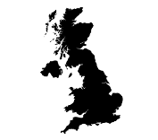
Although more than half of early-bird travellers plan to fly for their next trip,
Britons (-11%) are now slightly more reluctant
Top 5 markets which are most likely to travel by plane
in the next 6 months
Top 4 modes of transport for respondents most likely to travel
in the next 6 months
Italy
67.4%
Poland
13%
59.3%
Spain
65.4%
France
58.2%
UK
60.5%
11%
36
Q14.Which of the following modes of transport would you most consider using during your next trip within Europe?
No. of respondents: 3,246

Slide 37









Although staying at a hotel or resort is less popular than in previous waves,
it prevails as the go-to option for 52% of respondents
Preferred type of accommodation for respondents most likely to travel in the next 6 months
Hotel chain or resort
Short-term rental via online platform
Hotel chains/ resorts are popular among business travellers (36%) and sun & beach travellers (35%)
Hostel/motel
Independent hotel/
resort
Other paid serviced accommodation (bed and breakfast, etc.)
Other
Friends and/or family
Camping/caravan
37
* No significant changes between waves were recorded for this question
Q15.Which of the following types of accommodation would you most consider staying at during your next trip within Europe?
No. of respondents: 3,246

Slide 38
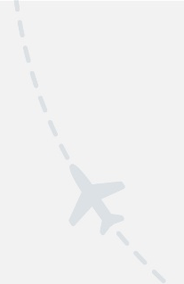
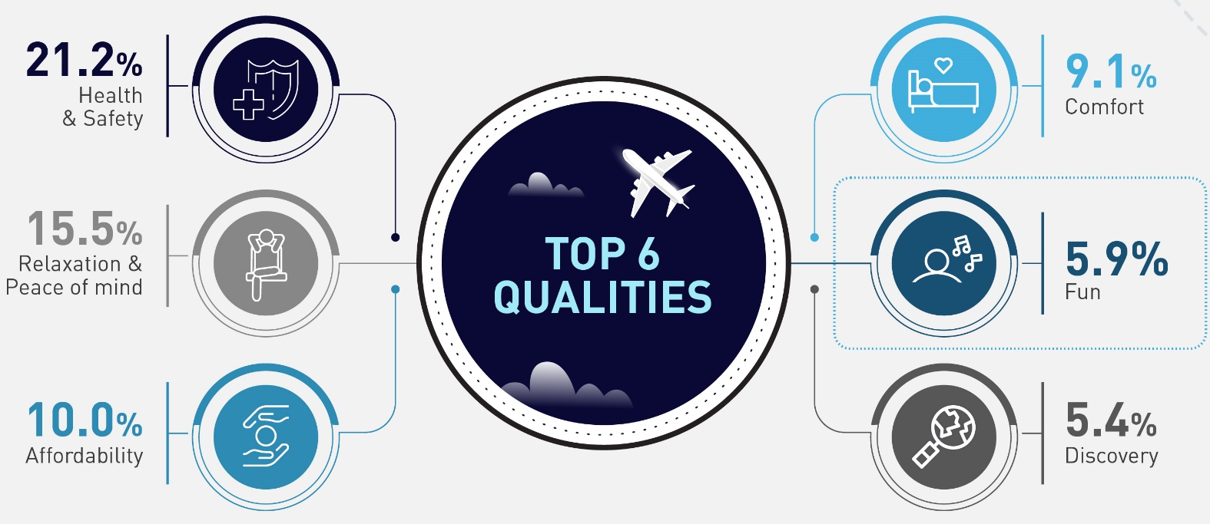
With relaxation, comfort and fun higher on everyone's agenda, COVID-19's grip on travel sentiment begins to slightly loosen
Feb ’21 survey
10%
*
The term “Travel Qualities” refers to the nature, traits and characteristics of the travel experience sought by consumers
38
*It is the first time for ‘Fun’ to appear in the top 6 travel qualities
Q20.Which of the following qualities regarding travel are more important to you now compared to last year?
No. of respondents: 5,837

Slide 39
TRAVEL CONCERNS
03

Slide 40





Despite Europe-wide efforts, travellers still face challenges sticking to their original plans. The majority shared that they had to reschedule or change their destination
How has COVID-19 affected travel plans
Top 5 markets which chose a domestic trip over international because of COVID-19
Austria
Did not plan to travel
38%
19.8%
Did not make any change to the original plan
Germany
19%
17.1%
Had to make some change to their original plan
Poland
15.8%
Switzerland
Cancelled
14.6%
Italy
14.5%
40
Q2.If you had planned an overnight trip in the next 6 months within Europe, how does COVID-19 affect your plans?
No. of respondents: 5,837

Slide 41









Destination effectiveness in managing COVID-19 and flexibility in cancellation lead trip planning factors; in-transport health and safety protocols a new entry
Most important factors to travel within Europe
Feb '21
survey
Dec '20- Jan '21
survey
Nov- Dec '20
survey
Oct- Nov '20
survey
Sep- Oct '20
survey
Aug- Sep '20
survey
Destinations’ effectiveness managing COVID-19
Flexible cancellation policies
Pre-travel COVID-19 tests
Finding a vaccine
Fully lifted travel restrictions
Health & safety protocols in destinations
Health & safety protocols during flight/transport
Health & safety protocols in accommodation
Social distancing on flights/public transport
41
* No significant changes between waves were recorded for this question.
Q3.Which factors are currently most important to you to travel within Europe?
No. of respondents: 5,837

Slide 42
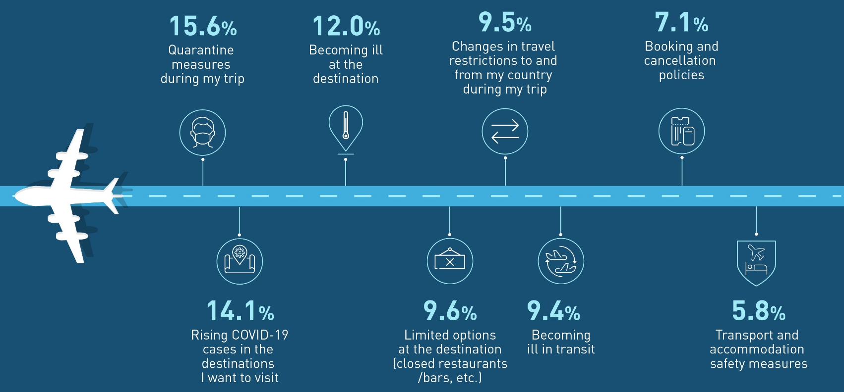
SIZING UP TRAVEL ANXIETIES
Quarantine at the destination remains a major deterrent to European travel
Leading concerns for travelling in Europe
Compared to other age groups, respondents over the age of 55 are slightly more concerned about the rising COVID-19 cases and becoming ill at the destination
42
* No significant changes between waves were recorded for this question.
No. of respondents: 5,837
Q4.What currently concerns you the most about travelling within Europe?

Slide 43
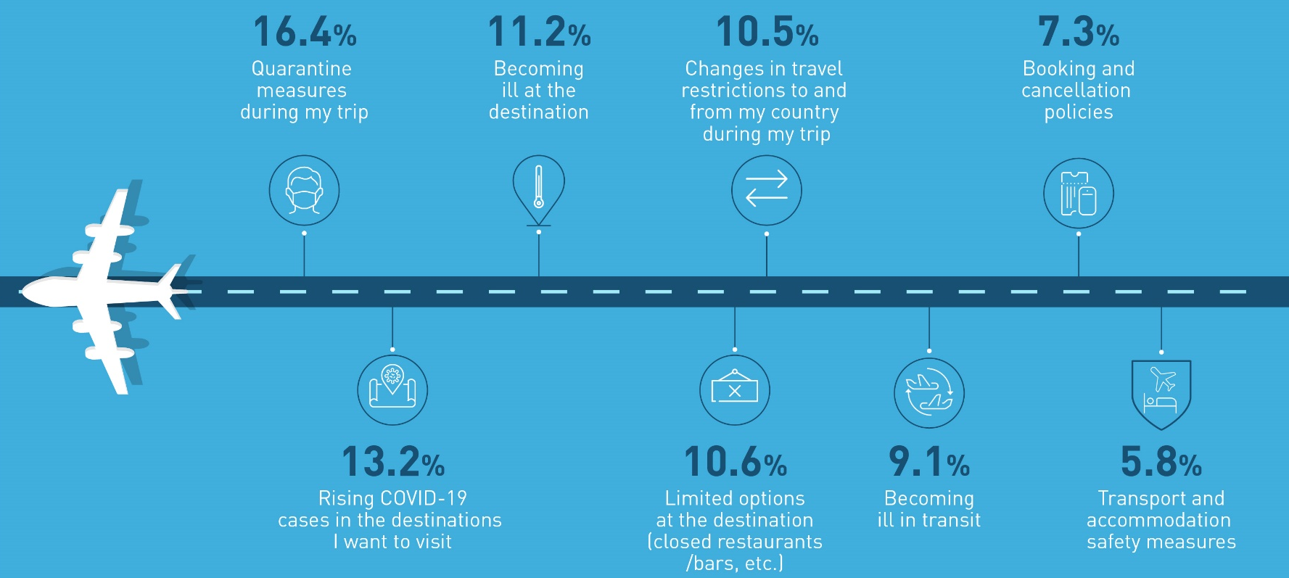
TRAVEL CONCERNS OF “EARLY-BIRD” TRAVELLERS
An increasing number of respondents with short-term plans question
whether they can get the most out of their in-destination experience
Leading concerns for those who are most likely to travel next
43
* No significant changes between waves were recorded for this question.
No. of respondents: 3,246
Q4.What currently concerns you the most about travelling within Europe?

Slide 44






Visiting destination’s bars and restaurants is now causing more anxiety among Europeans
The most worrisome touch points during travel
in relation to personal health & safety
Feb '21
survey
Dec '20- Jan '21
survey
Nov- Dec '20
survey
Oct- Nov '20
survey
Sep- Oct '20
survey
Aug- Sep '20
survey
Air travel
Accommodation – hotels and resorts
Food & beverage
Public areas in destinations (i.e., streets, neighborhoods)
In destination transport (metro, bus, taxi)
Attractions, tours and activities (i.e., museums, theme parks)
44
Q5.In relation to your personal health and safety, which parts of your journey will concern you the most?
No. of respondents: 5,837

Slide 45
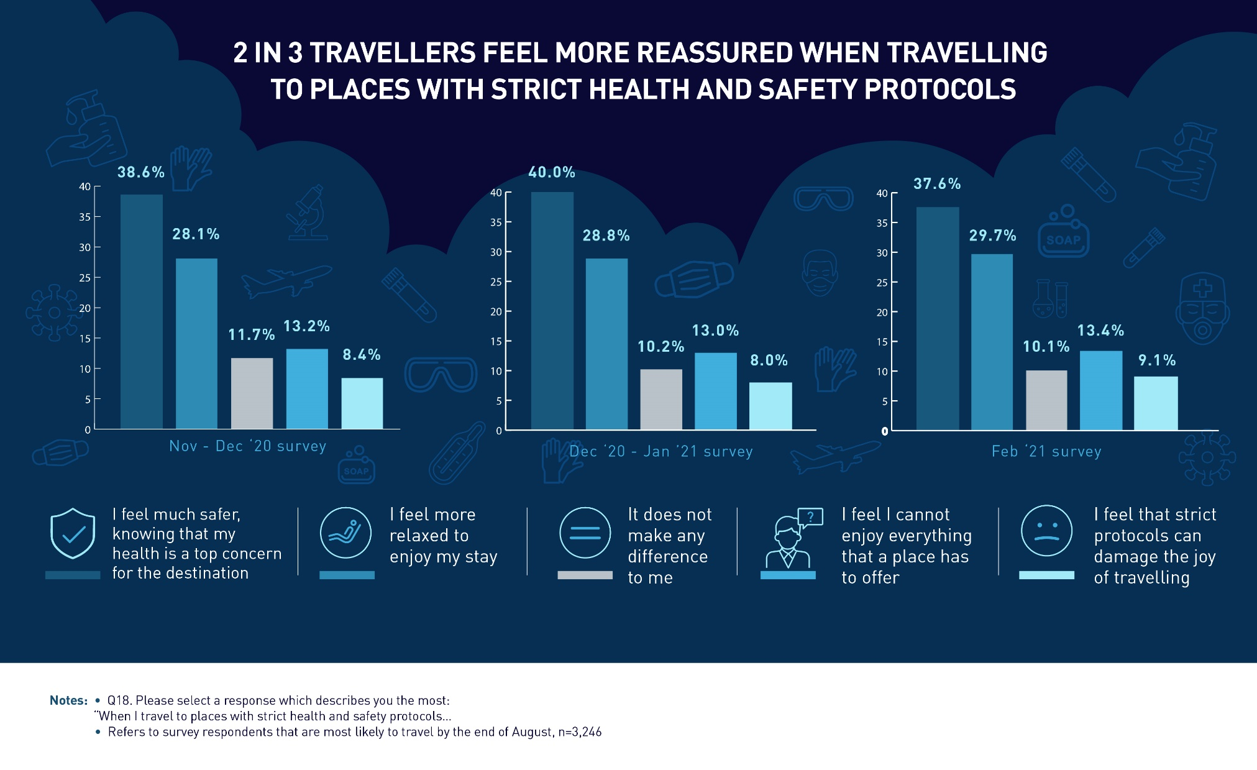
45

Slide 46




THE UNCERTAINTY CONTROL PANEL
4 KPIs illustrating the level of uncertainty
for domestic and intra-European travel
7.1% of respondents position booking and cancellation policies as one of the main concerns related to travelling
9.9%
10.4%
10.7%
10.1%
9.5%
10.3%
Aug- Sep '20
survey
Sep- Oct '20
survey
Oct- Nov '20
survey
Nov- Dec '20
survey
Dec ‘20- Jan ‘21
survey
Feb ‘21
survey
10.3% of respondents consider flexible cancellation policies as an important factor in travel decision-making
8.1%
8.3%
7.8%
7.1%
7.1%
6.9%
Aug- Sep '20
survey
Sep- Oct '20
survey
Oct- Nov '20
survey
Nov- Dec '20
survey
Dec ‘20- Jan ‘21
survey
Feb ‘21
survey
30.6% of respondents state that they do not know when they will travel next
10.4%
11.2%
12.8%
11.1%
10.7%
10.0%
38.8%
36.3%
34.7%
Aug- Sep '20
survey
Sep- Oct '20
survey
Oct- Nov '20
survey
Nov- Dec '20
survey
Dec ‘20- Jan ‘21 survey
Feb ‘21
survey
32.4%
34.3%
30.6%
Sep- Oct '20
survey
Nov- Dec '20
survey
Dec ‘20- Jan ‘21
survey
Feb ‘21
survey
10% of respondents state that they do not know where they intend to travel to in the next 6 months
Aug- Sep '20
survey
Oct- Nov '20
survey
46

Slide 47
METHODOLOGICAL ANNEX
04

Slide 48
METHODOLOGICAL ANNEX
THE SURVEY
Online market research. Survey participants are consumers with at least 2 overnight trips in 2019.
Distribution/ data collection period:
Wave 1: 27 August 2020 - 15 September 2020; sample= 5,762/ Wave 2: 21 September 2020 – 9 October 2020; sample= 5,876/ Wave 3: 19 October 2020 – 6 November 2020; sample= 5,832/ Wave 4: 20 November 2020 – 3 December 2020; sample= 5,742/ Wave 5: 18 December 2020 – 7 January 2021; sample= 5,855/ Wave 6: 5-19 February 2021; sample= 5,837
Countries: Germany, United Kingdom, France, Netherlands, Italy, Belgium, Switzerland, Spain, Poland and Austria
Languages: English, French, German, Italian, Spanish, Polish and Dutch
Research themes examined: Travel personas (1 question), Travel concerns and COVID-19 impact on travel (8 questions), Travel intentions, preferences and trip planning (10 questions), COVID-19 and responsible travel (3 questions).
Wave 6: 50% of respondents are male and 50% are female.
Number of respondents and age group per source country:
 |  | Country |  |  |  |  |  |  |  |  |  | Total
 |  | UK | IT | ES | AT | FR | DE | PL | BE | CH | NL
Age | 18 - 24 | 88 | 79 | 45 | 74 | 105 | 92 | 56 | 109 | 97 | 149 | 894
 | 25 - 34 | 135 | 120 | 74 | 134 | 142 | 153 | 106 | 113 | 125 | 141 | 1,243
 | 35 - 44 | 126 | 146 | 101 | 113 | 155 | 150 | 120 | 120 | 106 | 109 | 1,246
 | 45 - 54 | 138 | 180 | 105 | 96 | 161 | 168 | 93 | 78 | 42 | 54 | 1,115
 | ≥55 | 263 | 225 | 175 | 83 | 128 | 187 | 125 | 79 | 27 | 47 | 1,339
Total |  | 750 | 750 | 500 | 500 | 691 | 750 | 500 | 499 | 397 | 500 | 5,837
48

Slide 49
METHODOLOGICAL ANNEX
TRAVELLERS’ ONLINE SENTIMENT
Objective: Benchmark major European tourism destinations in terms of tourist satisfaction and interests based on social media mentions
Destinations: United Kingdom, France, Netherlands, Croatia, Belgium, Germany, Italy, Greece, Portugal and Spain
Origin markets; Germany, United Kingdom, France, Spain, Italy, Switzerland, Belgium, Netherlands, Poland and Austria
The following indicators are analysed:
TPI > The Tourist Products Index, measures the level of satisfaction with the offer (products) of the destination in its various categories: Arts & Culture, Gastronomy, Sunbathing, etc. This index is obtained by analysing the distribution of positive, negative and neutral comments on Twitter and TripAdvisor.
HIS > The Hotel Satisfaction Index, measures the level of visitor satisfaction with the entire accommodation sector of a destination based on relevant comments that guests make on TripAdvisor, Expedia and Booking.
Indexes are calculated by using advanced Natural Language Processing, Artificial Intelligence and Machine Learning techniques to analyse millions of spontaneous tourist interactions on social media or reviews sites.
Index scoring system: The calculated indices show values ​​between 0 and 100 points as follow:
0 to 24 points: Very low levels of satisfaction and confidence and therefore a priority area for reconfiguration.
25 to 49 points: Relatively low level of satisfaction and confidence. Considerable potential for improvement.
50 to 74 points: Good to very good satisfaction level. Moderate potential for improvement.
75 to 100 points: Excellent satisfaction and confidence levels. In some cases there are margins for improvement, although most of them constitute level to maintain and consolidate.
For a more detailed description about the specific indices please visit the following link.
49

Slide 50
Copyright © 2021 European Travel Commission (ETC)
This project is co-funded by the European Union
Study on Monitoring Sentiment for Intra-European Travel
All rights reserved. The contents of this report may be
quoted, provided the source is given accurately and
clearly. Distribution or reproduction in full is permitted for
own or internal use only.
While we encourage distribution via publicly accessible
websites, this should be done via a link to ETC’s
corporate website, www.etc-corporate.org
Data sources: This report is based on research conducted
by MINDHAUS (www.mindhaus.gr) in collaboration with Mabrian Technologies (www.mabrian.com) and should be interpreted by users according to their needs.
Please note that while every possible effort has been made to ensure the data in this report is accurate, it is not possible to completely eliminate every margin of error.
Published by the European Travel Commission
Rue du Marché aux Herbes, 61,
1000 Brussels, Belgium
Website: www.etc-corporate.org
Email: info@visiteurope.com
ISBN No: 978-92-95107-47-2 Cover photo : Jacob Lund, ID: 594296522 (Shutterstock)
Design: MINDHAUS
Co-funded by the European Union

