Slide 1



MONITORING SENTIMENT FOR DOMESTIC AND INTRA-EUROPEAN TRAVEL
10/20 | WAVE 2
Co-funded by the European Union

Slide 2
WAVE 2
RESEARCH HIGHLIGHTS
This report monitors sentiment and short-term intentions for domestic and intra-European travel, and it is the second out of six waves of market research, started in September 2020. Responses are collected from European citizens from 10 high-volume source markets in light of the COVID-19 crisis.
Despite a second wave of COVID-19 and with no approved vaccine yet, Europeans’ sentiment towards domestic and intra-regional travel remains stable and quite positive with 53.6% of respondents intending to travel in the next 6 months (compared to 53.5% in wave 1).
At the same time, sentiment is fairly similar towards domestic (38.8%) and intra-European travel (39.2%).
However, compared to wave 1, fewer Europeans are planning a trip in the next 2 months. The survey highlights an -18% drop in respondents wishing to travel before December 2020 and slight increases in uncertainty about the exact timing and destination of their trip (+5.8% and +7.6% respectively).
2

Slide 3
WAVE 2
RESEARCH HIGHLIGHTS
Quarantine measures remain the top concern for the largest share of travellers (14.9%) intending to take a trip in the near future. In the meantime, a growing number of respondents are now afraid of becoming ill at the destination (a +10% growth compared to wave1) indicating a fatigue in the travel sentiment for the short-term.
Rising COVID-19 cases at the destination (12.4%), transport and accommodation safety protocols (9.9%) as well as changes in travel restrictions during a trip (9.8%) are also triggering anxiety among an increasing number of potential travellers.
Among different age groups, the Gen Zers (aged 18-24) remain the least likely to travel in the coming 6 months.
3

Slide 4
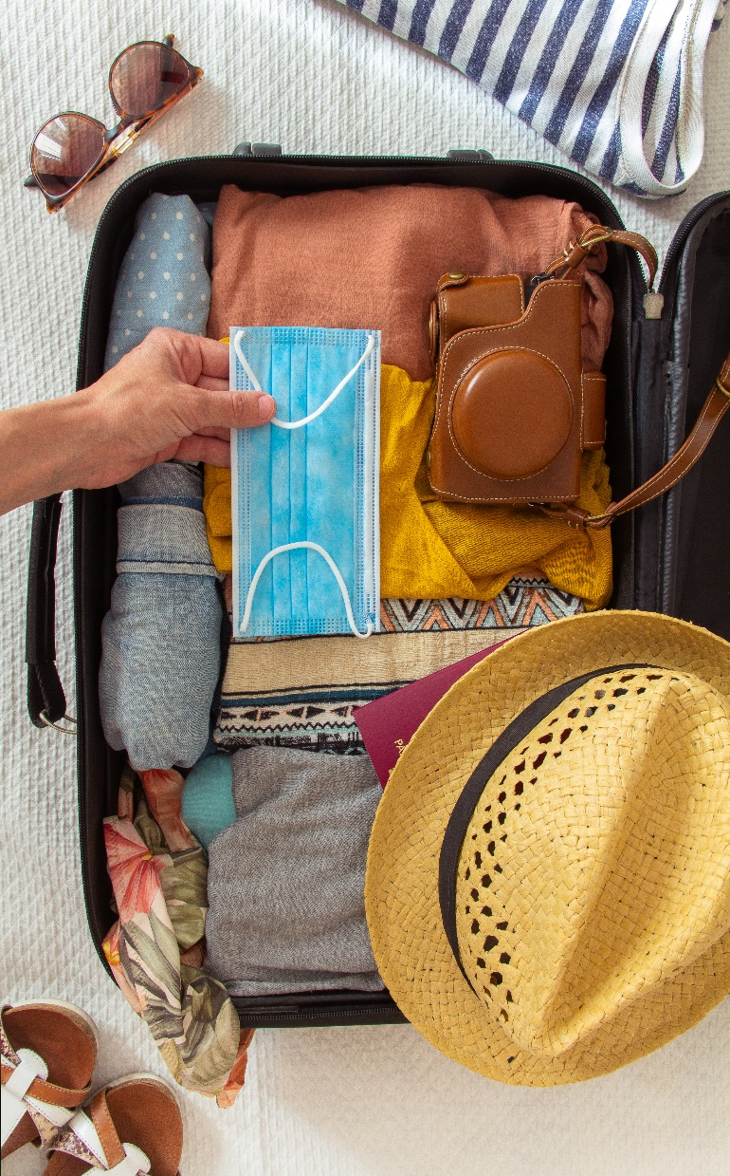
WAVE 2 RESEARCH HIGHLIGHTS
The vast majority of travellers will either make their next trip with their partner (36.1%) or their family (37.4%). Only 1% are planning a group trip in the coming 6 months.
Leisure remains the primary purpose of travel in the short-term for 64.9% of respondents. As the Christmas season approaches, visiting Friends and Relatives increased by +10%, and is now the main reason among 20.9% of Europeans. Business travel remains significant for 8.7% of respondents but still well below the benchmark of 13%¹.
4
¹ UNWTO International Tourism Highlights 2019

Slide 5
WAVE 2 RESEARCH HIGHLIGHTS
Despite the effect of COVID-19 on cities and urban destinations, city breaks prevail as the most favoured type of leisure trip among 20.3% of surveyed Europeans.
Other leading preferences include holidays in nature and the outdoors (14.9%), and trips with a focus on culture and heritage (14.7%).
Results also reveal a sharp growth (+39%), compared to wave 1, in people’s interest in skiing and snowboarding trips due to the winter season.
5

Slide 6
WAVE 2
RESEARCH HIGHLIGHTS
Spain (7.7%), Italy (7.5%) and France (6.8%) rank as the top-3 most preferred countries for outbound travel. Germany shows an +11.6% increase climbing to 4th place just above Greece which shows an -11.2% decline (compared to wave 1), among Europeans wishing to visit another country.
As expected, digital sources for travel inspiration and booking predominate; 66% of “early-bird” travellers¹ will rely on digital sources to plan their next trip, while 75% plan to book online. However, the role of expert travel advisors has gained weight, as 13.6% of respondents with short-term travel plans intend to book their next trip through a travel agent/ designer, an increase of +7.9% compared to wave 1.
With new COVID-19 cases on the rise, “Health and Safety” builds on its dominant position (21.4%) as a key consideration for any sought-after travel experience during the persisting pandemic. At the same time, Europeans are also very clear about how important “Peace of mind” (13.1%) and “Affordability” (12.3%) will be for their next trips.
6
¹ “Early-bird” travellers refers to survey respondents that are most likely to travel in the next 6 months

Slide 7
WAVE 2
RESEARCH HIGHLIGHTS
49.7% of early-bird travellers intend to fly by plane, while 36.2% choose their own car for the next trip.
55.4% of respondents will make their Intra-European trip by plane compared to 34.1% that prefer to travel by road. On the other hand, 46.9% of respondents who intent to travel domestically are likely to move by car (owned or rental), while 39.3% intend to fly.
In any case, air travel remains the most worrying part of a journey healthwise for 20.0% of Europeans.
Flexible cancellation policies (10.4%) is now the undisputed king for travel decision–making among all Europeans, slightly outscoring the possibility of a COVID-19 vaccine (10.0%).
7

Slide 8
WAVE 2
INSIGHTS ON TRAVELLERS’ ONLINE SENTIMENT
The report is also complemented by insights on travellers’ online sentiment¹ for major European destinations for the period of September 2020 compared to September 2019.
The weak travel sentiment of Gen Z (aged 18-24) is also reflected in online travel behaviour; the share of tourism-related social media mentions made by Gen Zers dropped from 16% in Sep. 2019 to 9% in Sep. 2020².
Tourists΄ satisfaction with the offering of European destinations fell -9.5% in Sep. 2020 compared to Sep. 2019 and -3.38% between August and September 2020. Tourism Product Index³ for September 2020 was 68.6 indicating that visitors to European destinations still experienced high satisfaction levels.
At the same time, tourist’s satisfaction with accommodation has remained stable or slightly improved during the pandemic; +2.4% for 5*, +0.4% for 4* and -1.8% for 3* hotels in Sep. 2019 compared to Sep. 2020. Hotel Satisfaction Index³ during September 2020 was 59.1 for 3* hotels, 63.9 for 4* and 62.6 for 5*.
8
¹ Benchmark report for major European destinations; September 2020 compared to September 2019 (Mabrian Technologies, October 2020)
²For more info on methodology and scoring system please refer to slide 53
³ Tourist Product/ Hotel Satisfaction Indexes, measure satisfaction levels of visitors to a destination with its offering (culture, gastronomy, sun and sea) & accommodation respectively

Slide 9

WAVE 2
RECOMMENDATIONS FOR DESTINATIONS
Pandemic fatigue is a drawback amongst travellers; thus governments and destinations should make sure that they ease the pressure, primarily through removing unnecessary administrative burdens and introducing clear regulations for all. Europeans with short-term plans should be viewed as ambassadors for rebuilding for more reluctant travellers.
The City break strengthens its position as the favourite type of trip, with people interested in city life, urban experiences and art most eager to travel in the coming 6 months. This means that while NTBs and DMOs¹ may be tempted to cut their marketing communication budgets, they should maintain their brand equity and top-of-mind position. Specifically, urban destinations can build engaging campaigns through community involvement, where creativity will carry more weight than “budget-needy”, high production values.
9
¹ NTBs –National Tourism Boards | DMOs – Destination Management/Marketing Organisations

Slide 10
WAVE 2
RECOMMENDATIONS FOR DESTINATIONS
The dominant preference for travelling with one’s family/partner should encourage destinations to develop and promote tailor-made products and experiences. These could include COVID-19 safe packages for family-friendly vacations or romantic getaways for Free Independent Travellers.
NTBs and DMOs should carefully investigate where there is untapped potential among different market segments and capitalize on that; as Gen Z (18-24) shows the weakest appetite to travel in the coming 6 months among all age groups but is the least concerned about air travel and quarantine measures, promoting the fun and adventurous aspect of outdoor activities or cities’ hidden gems during the winter season could be the key.
10

Slide 11

WAVE 2
RECOMMENDATIONS FOR BUSINESSES
Keep on prioritising health and safety. With health issues as well as transport and accommodation safety measures a growing concern among European travellers, service providers should continue diligently developing, implementing and communicating protocols that ease consumer sentiment.
Air travel is vital for the short-term recovery of the industry. Building consumer trust through pre-flight COVID-19 testing and introducing physical distancing during flights cannot be understated. On the other hand, airlines may need to rethink the impact of COVID-19 travel insurance policies on consumer trust. Only 3.1% of Europeans consider the availability of travel insurance as an important factor when deciding for their trip.
11

Slide 12
WAVE 2
RECOMMENDATIONS FOR BUSINESSES
Flexible cancellation policies are now the primary factor in travel decision-making and essential to facilitating bookings. Businesses (airlines, accommodation providers, etc.) can gain consumers’ confidence by creating and flagging a simple, straightforward and transparent cancellation policy.
With Peer-to-Peer review websites and recommendations from friends gaining more traction in the travel inspiration phase, tourism businesses that will be consistent, faithful to their promise and provide value beyond expectations will shorten the odds on a faster recovery.
12

Slide 13
CONTENTS
01. | 02. | 03. | 04.
TRAVEL | TRIP | TRAVEL | METHODOLOGICAL
INTENTIONS | PLANNING | CONCERNS | ANNEX
P. 15 | P. 36 | P. 43 | P. 50

Slide 14
How to read
Wave 2
To present data and insights, the following distinct groups have been analysed:
Total respondents; 5,876
Respondents with short-term travel plans/ most likely to travel (”early-bird travellers”) in the next 6 months; 3,148
Respondents selecting outbound European destinations; 4,027
Wave 2 data collection period: 21/9/2020 – 9/10/2020.
To present the timing in which respondents are most likely to take their next trip, the following time periods should be used as a reference:
This month; September – October 2020.
In 1-2 months; October – December 2020.
In 3-4 months; December 2020 – February 2021.
In 5-6 months; February - April 2021.
All data and insights refer to domestic and intra-European travel, unless otherwise stated.
The following symbols depicted in texts/ graphs show trends between the current research wave versus the previous one.
Increasing , decreasing , stable
When mention of new COVID-19 is made, it refers to the data collection period.
14

Slide 15

TRAVEL INTENTIONS
01

Slide 16





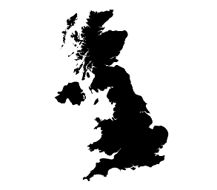
The importance of a COVID-19 vaccine for resuming travel is increasing, but still its effect will not be instant
Top 5 markets most likely to resume travel when a COVID-19 treatment is found
Intention to re-schedule a pre COVID-19 trip immediately after a treatment/ vaccine is found
Spain
62.4%
Italy
Poland
51.5%
57.0%
Germany
UK
43.5%
51.7%
16
Q6.To what extent do you agree/ disagree with the following statement: “when a treatment/ vaccine for COVID-19 is found, I will immediately book or reschedule the trip I had planned pre-COVID 19”
No. of respondents: 5,876

Slide 17


Travel sentiment remains stable and positive - over half of respondents intend to take a trip in the next 6 months
Top 5 markets which are most likely
to travel in the next 6 months
Intention to travel in the next 6 months
Poland
77.0%
Spain
Italy
54.2%
59.7%
Belgium
Germany
53.6%
57.5%
17
Q7.Do you plan to take an overnight trip domestically or within Europe in the next 6 months, either for personal or professional purposes?
No. of respondents: 5,876

Slide 18





All age groups continue to exhibit the same desire to travel in the next 6 months.
18-24
Members of Gen Z (18-24) continue to show lower enthusiasm for travel, with the share of tourism-related social media mentions dropping from 16% (Sep 2019) to 9% (Sep 2020)¹
25-34
35-44
45-54
>54
¹Benchmark report for major European destinations September 2020 compared to September 2019 (Mabrian Technologies, October 2020)
Wave 2
18
Q7.Do you plan to take an overnight trip domestically or within Europe in the next 6 months, either for personal or professional purposes?
No. of respondents: 5,876

Slide 19
City life enthusiasts continue to exhibit the strongest desire to resume travel
in the next 6 months
Respondents most likely to travel in the next 6 months, per type of traveller
Sun & beach lovers
Bleisure travellers
Business travellers
Explorers of cultural identity & roots
Immersive explorers
City life enthusiasts
Gastronomy lovers
19
Q7.Do you plan to take an overnight trip domestically or within Europe in the next 6 months, either for personal or professional purposes?
No. of respondents: 3,148
No. of respondents: 5,762

Slide 20
Winter makes the effect of COVID-19 worse: intention to travel by the end of 2020 weakens (-18%) while uncertainty about destination choice is on the rise (+8%)
When will Europeans travel next?
Where will Europeans travel within the next 6 months?
8%
For specific dates please refer to slide 14
20
Q9.When are you most likely to go on your next trip either in your country or within Europe?
Q10.Where do you plan to travel in the next 6 months?
No. of respondents: 5,876
No. of respondents: 5,876

Slide 21
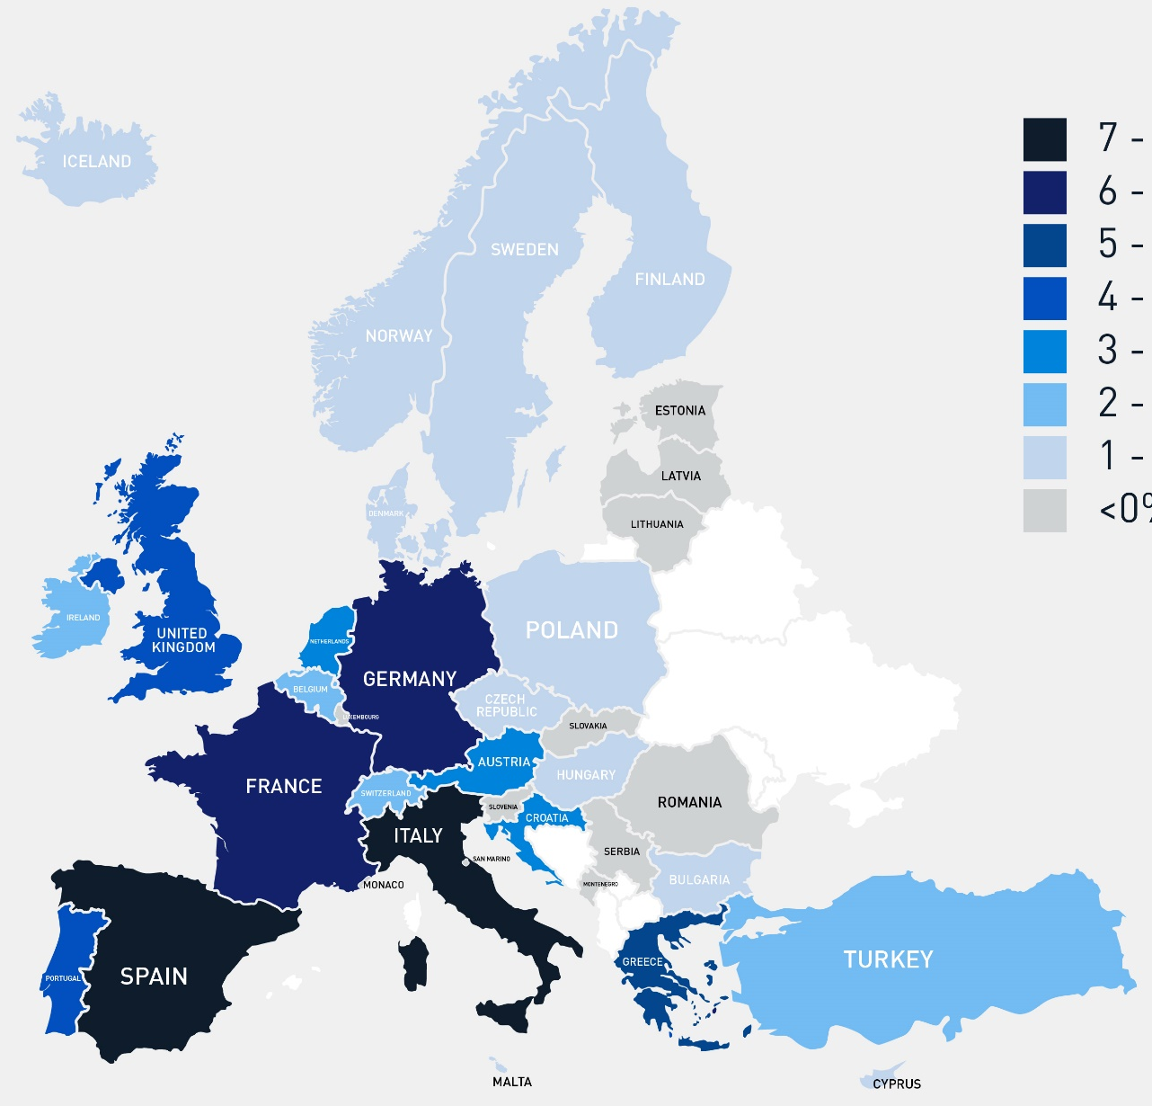

PREFERRED COUNTRIES FOR THE NEXT INTRA-ΕUROPEAN TRAVEL
Countries at the top of the wish list lead epidemiological trends as well
TOP 10 COUNTRIES
Spain
Italy
France
Germany
Greece
United Kingdom
Portugal
Croatia
Austria
Netherlands
7.7%
7.5%
6.8%
6.7%
5.5%
4.9%
4.5%
3.6%
3.5%
3.2%
Please use this map as a reference only
No. of respondents: 4,027
21
Q11. To which country(ies) do you plan to travel next?

Slide 22


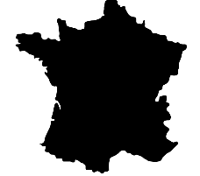

The majority of respondents plan to travel for leisure or to visit friends and relatives
Purpose of travel for respondents
most likely to travel in the next 6 months
Top 3 markets to resume
leisure travel
Top 3 markets to resume
business travel
France
Spain
73.3%
13.2%
Italy
Germany
70.9%
12.3%
Poland
Austria
69.3%
10.9%
22
Q8.For what reason are you most likely to travel within Europe next?
No. of respondents: 3,148

Slide 23
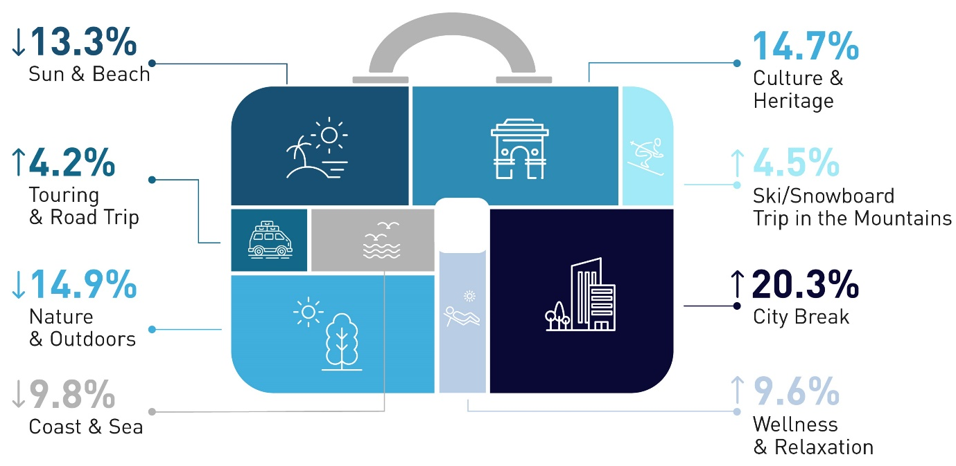

The city break rises (+6%) to the top of the list of favourite types of leisure trips in the next 6 months
Preferred type of leisure trip for respondents most likely to travel in the next 6 months
Seasonal changes:
Wave 2 reveals a growing interest in ski and snowboard (+39%) over coast and sea (-18%) as winter season approaches. However, an appetite for culture and heritage trips has held steady
Wave 2
23
Q17.What type of leisure trip within Europe are you most likely to undertake next?
No. of respondents: 3,148

Slide 24



Markets remain loyal to specific tourism products; Spaniards show the strongest interest in City Breaks, Germans and Dutch in Nature and Outdoors, while Italians and Polish favour Culture and Heritage
City Break
Nature & Outdoors
Culture & Heritage
How to read: Percentages indicate the share of respondents from each country interested in each type of leisure trip; i.e. 41.2% of respondents from Spain are most likely to undertake a city break trip
24
Q17.What type of leisure trip within Europe are you most likely to undertake next?
No. of respondents: 5,876

Slide 25



Markets remain loyal to specific tourism products; the British have a strong preference for Sun and Beach, French to Coast & Sea while the Swiss lead in Cruising
Sun & Beach
Coast & Sea
Cruising
How to read: Percentages indicate the share of respondents from each country interested in each type of leisure trip; i.e. 24.9% of respondents from UK are most likely to undertake a sun and beach trip
25
Q17.What type of leisure trip within Europe are you most likely to undertake next?
No. of respondents: 5,876

Slide 26
GERMANY
Willingness to travel grows (+9%) but respondents are less certain about the exact timing and destination of their next trip
Willingness to travel in the next 6 months
When will Germans travel?
Where will Germans travel within the next 6 months?
9%
Wave 1
Wave 2
For specific dates please refer to slide 14
Q7.Do you plan to take an overnight trip domestically or within Europe in the next 6 months, either for personal or professional purposes?
Q9.When are you most likely to go on your next trip either in your country or within Europe?
Q10.Where do you plan to travel in the next 6 months?
26
No. of respondents: 750

Slide 27
UNITED KINGDOM
Among analysed markets, British respondents are most uncertain about when they will go on a trip next
Willingness to travel in the next 6 months
When will Britons travel?
Where will Britons travel within the next 6 months?
Wave 1
Wave 2
For specific dates please refer to slide 14
Q7.Do you plan to take an overnight trip domestically or within Europe in the next 6 months, either for personal or professional purposes?
Q9.When are you most likely to go on your next trip either in your country or within Europe?
Q10.Where do you plan to travel in the next 6 months?
27
No. of respondents: 750

Slide 28
FRANCE
With a steady rise of new COVID-19 cases in the country, respondents’ intention to travel within the next 2 months declines (-12%)
Willingness to travel in the next 6 months
When will French travel?
Where will French travel within the next 6 months?
Wave 2
Wave 1
Wave 2
For specific dates please refer to slide 14
Q7.Do you plan to take an overnight trip domestically or within Europe in the next 6 months, either for personal or professional purposes?
Q9.When are you most likely to go on your next trip either in your country or within Europe?
Q10.Where do you plan to travel in the next 6 months?
28
No. of respondents: 734

Slide 29

NETHERLANDS
Dutch respondents are less positive (-13%) about trips in the next 6 months but they are more interested in international than domestic travel
Willingness to travel in the next 6 months
When will Dutch travel?
Where will Dutch travel within the next 6 months?
13%
Wave 1
Wave 2
For specific dates please refer to slide 14
Q7.Do you plan to take an overnight trip domestically or within Europe in the next 6 months, either for personal or professional purposes?
Q9.When are you most likely to go on your next trip either in your country or within Europe?
Q10.Where do you plan to travel in the next 6 months?
29
No. of respondents: 500

Slide 30
ITALY
The majority of respondents do not plan to go on a trip before 2021 and show a clear preference to travel within their country
Willingness to travel in the next 6 months
When will Italians travel?
Where will Italians travel within the next 6 months?
Wave 1
Wave 2
For specific dates please refer to slide 14
Q7.Do you plan to take an overnight trip domestically or within Europe in the next 6 months, either for personal or professional purposes?
Q9.When are you most likely to go on your next trip either in your country or within Europe?
Q10.Where do you plan to travel in the next 6 months?
30
No. of respondents: 750

Slide 31
BELGIUM
Travel confidence improves (+9%) and so does respondents’ interest in visiting other European destinations
Willingness to travel in the next 6 months
When will Belgians travel?
Where will Belgians travel within the next 6 months?
9%
Wave 1
Wave 2
For specific dates please refer to slide 14
Q7.Do you plan to take an overnight trip domestically or within Europe in the next 6 months, either for personal or professional purposes?
Q9.When are you most likely to go on your next trip either in your country or within Europe?
Q10.Where do you plan to travel in the next 6 months?
31
No. of respondents: 500

Slide 32

SWITZERLAND
Respondents’ appetite for trips in the next 6 months drops significantly (-18%) as COVID-10 cases spike in the country
Willingness to travel in the next 6 months
When will Swiss travel?
Where will Swiss travel within the next 6 months?
18%
Wave 1
Wave 2
For specific dates please refer to slide 14
Q7.Do you plan to take an overnight trip domestically or within Europe in the next 6 months, either for personal or professional purposes?
Q9.When are you most likely to go on your next trip either in your country or within Europe?
Q10.Where do you plan to travel in the next 6 months?
32
No. of respondents: 392

Slide 33
SPAIN
Respondents shelve their travel plans for the rest of 2020 with less certainty about the exact timing of their next trip
Willingness to travel in the next 6 months
When will Spaniards travel?
Where will Spaniards travel within the next 6 months?
11%
Wave 1
Wave 2
For specific dates please refer to slide 14
Q7.Do you plan to take an overnight trip domestically or within Europe in the next 6 months, either for personal or professional purposes?
Q9.When are you most likely to go on your next trip either in your country or within Europe?
Q10.Where do you plan to travel in the next 6 months?
33
No. of respondents: 500

Slide 34
POLAND
Travel sentiment is most positive in Poland as more than 1 in 2 respondents (53%) are eager to take a trip in early 2021
Willingness to travel in the next 6 months
When will Poles travel?
Where will Poles travel within the next 6 months?
21%
Wave 1
Wave 2
For specific dates please refer to slide 14
Q7.Do you plan to take an overnight trip domestically or within Europe in the next 6 months, either for personal or professional purposes?
Q9.When are you most likely to go on your next trip either in your country or within Europe?
Q10.Where do you plan to travel in the next 6 months?
34
No. of respondents: 500

Slide 35
AUSTRIA
Uncertainty grows (+15%) as to when Austrians will travel next, planning mainly for 2021
Willingness to travel in the next 6 months
When will Austrians travel?
Where will Austrians travel within the next 6 months?
15%
Wave 1
Wave 2
For specific dates please refer to slide 14
Q7.Do you plan to take an overnight trip domestically or within Europe in the next 6 months, either for personal or professional purposes?
Q9.When are you most likely to go on your next trip either in your country or within Europe?
Q10.Where do you plan to travel in the next 6 months?
35
No. of respondents: 500

Slide 36

TRIP PLANNING
02

Slide 37





The majority of surveyed Europeans intend to travel with their family (+5%) or partner (-3%) in the mid-term
Preferred travel companion for respondents most likely to travel in the next 6 months
With my family
The travel companion lifecycle: respondents aged 18-24 are more likely to travel with friends, while those aged 35-54 prefer to travel with their family. Respondents aged 25-34 and over 55 are more likely to travel as a couple.
Wave 1
Wave 2
Other
For domestic trips, 76% of Europeans will be accompanied by their family or partner while 12% will travel solo
For trips outside Europe, 64% of respondents will travel with their family or partner compared to 20% that will travel solo
With my partner
With friends
37
By myself
Q16.With whom are you most likely to travel during your next trip within Europe?
No. of respondents: 3,148

Slide 38

Respondents demonstrate a stable preference for digital sources,
with 2 out of 3 intending to use online information to plan their next trip
Top 10 preferred sources of information for respondents most likely to travel in the next 6 months
The importance of personal recommendations is even greater for those planning to travel domestically
20.8%
12.1%
11.7%
10.8%
10.0%
8.1%
8.1%
6.1%
3.7%
3.6%
Travel review websites
A hotel website or social media
Recommendations from friends
Destination website or social media
Travel agent/ tour operator
An airline website or social media
An online travel video on YouTube, Facebook, etc.
Newspaper/ magazine articles
Digital content from someone followed on Social Media
A travel show on television/ OnDemand/ podcast
38
Q12.What sources of information will you use the most when planning your next trip?
NB: Sampling carried out through online survey thus it may contain bias towards digital usage
No. of respondents: 3,148

Slide 39


3 out of 4 respondents will book their next trip through digital platforms
as online booking engines dominate among consumers
19% of respondents over the age of 55 will book via a travel agent/ designer
3.9%
Corporate travel office
7.8%
Package holiday through
a Tour Operator
13.6%
Travel agent/
travel designer
Wave 1
Wave 2
49.4%
Online booking engine
+4%
25.2%
Direct booking via
accommodation/ airline website
NB: Sampling carried out through online survey thus it may contain bias towards digital usage
39
Q13.How will you book your next trip within Europe?
No. of respondents: 3,148

Slide 40

Air travel still not taking-off to pre-pandemic levels while driving holds its traction among Europeans
Top 5 markets which are most likely to travel by plane
in the next 6 months
Top 4 modes of transport for respondents most likely to travel
in the next 6 months
Spain
70.1%
France
UK
57.3%
65.2%
Poland
Italy
53.8%
59.4%
40
Q14.Which of the following modes of transport would you most consider using during your next trip within Europe?
No. of respondents: 3,148

Slide 41

Over half of respondents prefer to stay at a hotel or resort. Meanwhile, with Christmas approaching, staying with friends and family is becoming a stronger preference
Preferred type of accommodation for respondents most likely to travel in the next 6 months
Other paid serviced accommodation (i.e. bed and breakfast, parador, etc.)
Camping/caravan
Other
Hotel chain or resort
The preference for a hostel/ motel is higher among respondents below the age of 34
Short-term rental via online platform
Hostel/motel
Wave 1
Wave 2
Friends and/or family
Independent hotel/resort
No. of respondents: 3,148
41
Q15.Which of the following types of accommodation would you most consider staying at during your next trip within Europe?

Slide 42
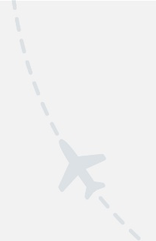
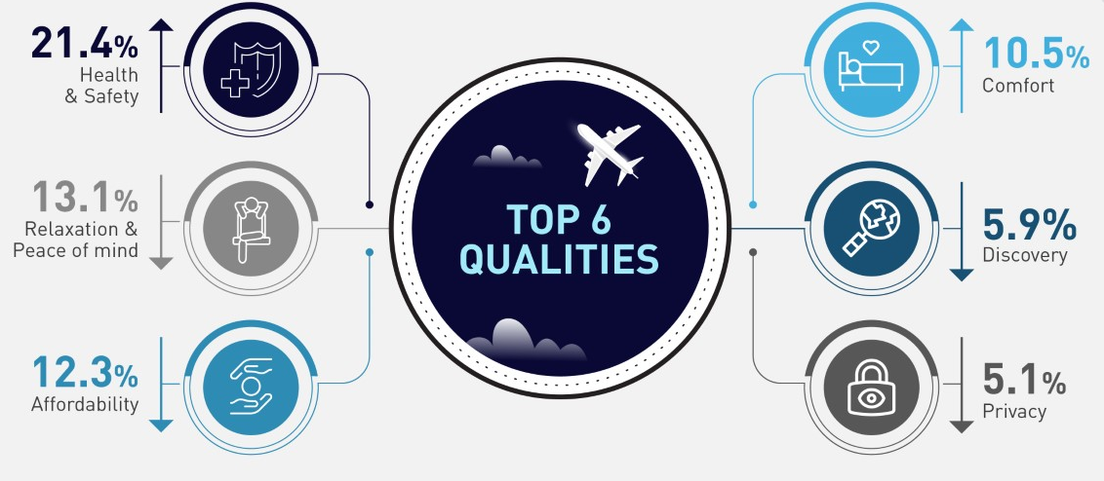
With Europe witnessing a second wave of COVID-19, health and safety still head the list
of key criteria for any travel-related choice
The term “Travel Qualities” refers to the nature, traits and characteristics of the travel experience sought by consumers
42
Q19.Which of the following qualities regarding travel are more important to you now compared to last year?
No. of respondents: 5,876

Slide 43
TRAVEL CONCERNS
03

Slide 44
Despite the impact of COVID-19 more than 1 in 2 Europeans remain committed to travel
and will change plans to ensure their trip still goes ahead
How has COVID-19 affected travel plans
Top 5 markets which chose a domestic trip over international because of COVID-19
Insist on travelling
and will
change
plans
Poland
21.8%
Respondents planning a ski/ snowboard trip are more likely to keep their original travel plans despite the pandemic
Austria
21.4%
Switzerland
19.4%
Germany
18.5%
Italy
15.9%
44
No. of respondents: 5,876
Q2.If you had planned an overnight trip in the next 6 months within Europe, how does COVID-19 affect your plans?

Slide 45







“Flexible cancellation policies” now outscore “finding a vaccine for COVID-19” as the leading factor in travel decision-making among Europeans
The availability of travel insurance is an important factor for only 3.1% of Europeans
Respondents over 55 put more emphasis on finding a vaccine and on health and safety protocols at the destination, compared to younger audiences
Wave 1
Wave 2
45
Q3.Which factors are currently most important to you when travelling within Europe?
No. of respondents: 5,876

Slide 46
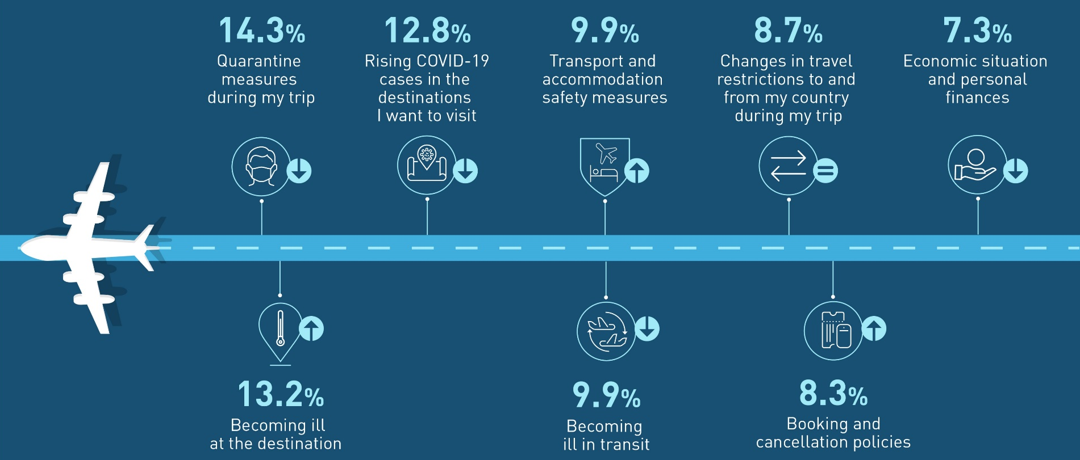
SIZING UP TRAVEL ANXIETIES
Health concerns are still at the forefront of travellers’ sentiment; yet quarantine measures persist as the major deterrent for travel among Europeans
Leading concerns for travelling in Europe
46
Q4.What currently concerns you the most about travelling within Europe?
No. of respondents: 5,876

Slide 47
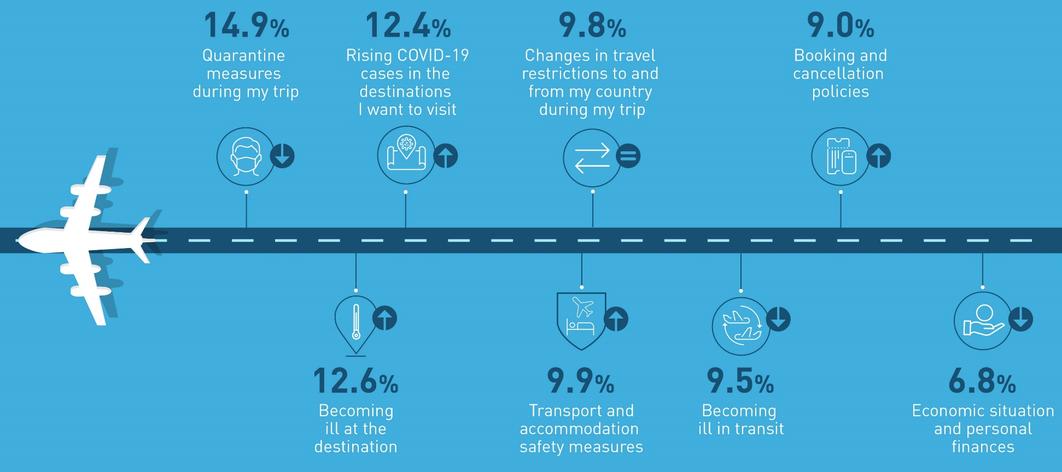
TRAVEL CONCERNS OF “EARLY BIRD” TRAVELLERS
Becoming ill at the destination and rising COVID-19 cases are now growing anxieties for “early bird” travellers
Leading concerns for those who are most likely to travel next
47
Q4.What currently concerns you the most about travelling within Europe?
No. of respondents: 3,148

Slide 48






Both transport to and within the destination remains the most stressful part of a journey in relation to personal health and safety
The most worrisome touch points during travel
in relation to personal health & safety
(Top 5)
Britons are the most concerned about air travel. Respondents from Austria, Germany and Poland are less anxious in this regard.
48
Q5.In relation to your personal health and safety, which parts of your journey will concern you the most?
No. of respondents: 5,876

Slide 49



THE UNCERTAINTY CONTROL PANEL
As new COVID-19 cases surge in Europe, respondents’ sentiment towards travel
reveal an increasing sense of uncertainty
4 KPIs showcasing the level of uncertainty for domestic and intra-European travel
10.4% of respondents consider flexible cancellation policies as an important factor for travel decision - making
8.3% of respondents classify booking and cancellation policies as one of the main concerns related to travelling
34.3% of respondents state that they do not know when they will travel next
11.2% of respondents state that they do not know where they intend to travel in the next 6 months
34.3%
32.4%
10.4%
8.3%
10.4%
11.2%
9.9%
8.1%
49
Wave 2
Wave 1
Wave 2
Wave 1
Wave 1
Wave 2
Wave 1
Wave 2
No. of respondents: 5,876

Slide 50
METHODOLOGICAL ANNEX
04

Slide 51
METHODOLOGICAL ANNEX
THE SURVEY
Online market research survey
Distribution/ data collection period:
Wave 1: 27 August 2020 - 15 September 2020
Wave 2: 21 September 2020 – 9 October 2020
Consumers with at least 2 overnight trips in 2019 participated in the survey
Wave 1: 5,762 & Wave 2: 5,876 respondents in total, from 10 high-volume European source markets
Countries: Germany, United Kingdom, France, Netherlands, Italy, Belgium, Switzerland, Spain, Poland and Austria
Languages: English, French, German, Italian, Spanish, Polish and Dutch.
Research themes examined: Travel personas (1 question), Travel concerns and COVID-19 impact on travel (6 questions), Travel intentions, preferences and trip planning (10 questions), COVID-19 and responsible travel (3 questions)
Wave 1 & Wave 2: 51% of respondents are male and 49% are female
Wave 2 - Number of respondents and age group per source country:
 |  | Country |  |  |  |  |  |  |  |  |  | Total
 |  | UK | IT | ES | AT | FR | DE | PL | BE | CH | NL
Age | 18 - 24 | 88 | 73 | 45 | 78 | 106 | 92 | 56 | 153 | 108 | 143 | 942
 | 25 - 34 | 135 | 112 | 74 | 137 | 142 | 153 | 106 | 140 | 109 | 157 | 1265
 | 35 - 44 | 126 | 135 | 101 | 131 | 154 | 150 | 120 | 92 | 89 | 106 | 1204
 | 45 - 54 | 138 | 167 | 105 | 80 | 160 | 168 | 93 | 63 | 60 | 66 | 1100
 | >54 | 263 | 263 | 175 | 74 | 172 | 187 | 125 | 52 | 26 | 28 | 1365
Total |  | 750 | 750 | 500 | 500 | 734 | 750 | 500 | 500 | 392 | 500 | 5,876
51

Slide 52
METHODOLOGICAL ANNEX
TRAVELLERS’ ONLINE SENTIMENT
Objective: Benchmark major European tourism destinations in terms of tourist satisfaction and interests.
Behavioural modes: Insights based on social media mentions
Destinations: United Kingdom, France, Netherlands, Croatia, Belgium, Germany, Italy, Greece, Portugal and Spain
Origin markets; Germany, United Kingdom, France, Spain, Italy, Switzerland, Belgium, Netherlands, Poland and Austria
Data subject to availability
Domestic market excluded
The following indicators are analysed:
TPI > The Tourist Products Index, measures the level of satisfaction with the offer (products) of the destination in its various categories: Cultural, Gastronomic, etc. This index is obtained by analysing the distribution of positive, negative and neutral comments that are produced for each of these products on Twitter and Tripadvisor.
HIS > The Hotel Satisfaction Index, measures, as the name suggests, the level of visitor satisfaction with the entire accommodation sector of a destination for three, four and five-star hotels, based on comments on the accommodation offer that guests make on Tripadvisor, Expedia and Booking.
52

Slide 53
METHODOLOGICAL ANNEX
TRAVELLERS’ ONLINE SENTIMENT
The indexes are calculated by using advanced Natural Language Processing, Artificial Intelligence and Machine Learning techniques to analyse millions of spontaneous tourist interactions on social media or reviews sites. It enables the identification of tourist mentions (from visitors or potential visitors) related to some specific issue (i.e. Product, Hotel, Security, Climate) and the sentiment associated with them. The machine sorts the mentions in three categories: positive, neutral and negative and calculates the index based on volumes and share of each of them.
Index scoring system: The calculated indices show values ​​between 0 and 100 points. Below, the rating scale is shown to know the meaning and evolution of the indicators over time.
0 to 24 points: Those indicators or indices that are within this scale, show very low levels of satisfaction and confidence and therefore are a priority area for reconfiguration.
25 to 49 points: Relatively low level of satisfaction and confidence. Important potential for improvement.
50 to 74 points: Good to very good satisfaction level. Moderate potential for improvement.
75 to 100 points: Excellent satisfaction and confidence levels. In some cases there are margins for improvement, although in most of them they are levels to maintain and consolidate.
For a more detailed description about the specific indices please visit the following link.
53

Slide 54
Copyright © 2020 European Travel Commission (ETC)
This project is co-funded by the European Union
Study on Monitoring Sentiment for Intra-European Travel
All rights reserved. The contents of this report may be
quoted, provided the source is given accurately and
clearly. Distribution or reproduction in full is permitted for
own or internal use only.
While we encourage distribution via publicly accessible
websites, this should be done via a link to ETC’s
corporate website, www.etc-corporate.org
Data sources: This report is based on research conducted
by MINDHAUS (www.mindhaus.gr) in collaboration with Mabrian Technologies (www.mabrian.com) and should be interpreted by users according to their needs.
Please note that while every possible effort has been made to ensure the data in this report is accurate, it is not possible to completely eliminate every margin of error.
Published by the European Travel Commission
Rue du Marché aux Herbes, 61,
1000 Brussels, Belgium
Website: www.etc-corporate.org
Email: info@visiteurope.com
ISBN No: 978-92-95107-40-3
Design: MINDHAUS
Image ID: 1204292545 Copyright: KONGSTOCK/Shutterstock
Co-funded by the European Union

