Slide 1



MONITORING SENTIMENT FOR DOMESTIC AND INTRA-EUROPEAN TRAVEL
09/20 | WAVE 1
Co-funded by the European Union

Slide 2
WAVE 1
RESEARCH HIGHLIGHTS
This report examines and monitors sentiment and short-term intentions for domestic and intra-regional travel of European citizens from 10 high-volume source markets in light of the COVID-19 crisis, and is the first out of six waves of market research, conducted in August 2020 onwards.
Europeans demonstrate an optimistic sentiment towards travel; 54% of respondents intend to take a trip in the next 6 months while 26% state that they plan to travel until November 2020. Travel in Europe is a top choice with 41% intending to travel within their own country and 39% to other European destinations. Only 11% consider a trip outside Europe in the next months.
The large majority of respondents who are more eager to travel, domestically or within Europe, in the next 6 months, will plan a leisure trip (66%). Other purposes include Visiting Friends and Relatives (19%) and Business Travel (9%).
2

Slide 3

WAVE 1 RESEARCH HIGHLIGHTS
Sea, sun and beach (25%), city break (19%) as well as nature and outdoors (16%) are the most appealing types of leisure trips among respondents eager to travel in the next 6 months.
Respondents exhibiting a greater interest in city breaks are the ones most likely to travel sooner.
The majority of respondents who planning short-term trips intend to travel, domestically or within Europe, either with their partner (37%) or with their family (36%). Only, a fragment will travel with friends (13%) or solo (10%).
3

Slide 4
WAVE 1
RESEARCH HIGHLIGHTS
Finding a treatment/vaccine for COVID-19 is expected to have only a mildly positive impact on travel, at least for the short-term, as only 44% of respondents state that they intend to plan their pre COVID-19 trip immediately after a treatment or vaccine has been found.
Quarantine measures during a trip (15%), rising numbers of COVID-19 cases (12%) or getting ill at the destination (11%) as well as changing travel restrictions (10%), are the primary concerns for “early bird” travellers.
With regard to personal health, air travel is considered the less safe part of a journey (20%) with fewer than 50% of respondents stating that they intend to travel by plane on their next trip*.
The substantial climate of uncertainty is also highlighted by the large part of respondents (32%) that have not yet made a decision as to when they will take their next trip.
4
*According to UNWTO data, in 2018 the share of air travel in tourism was 58%.

Slide 5
WAVE 1 RESEARCH HIGHLIGHTS
No factor is more important than flexible cancellation policies (11%) for travel decision making among respondents with short-term plans.
Europeans ask primarily for health and safety (21%) for their next travels but peace of mind & relaxation (14%) as well as affordability (13%) of a trip are also keys for a highly sought-after travel experience.
Travel motivation is resilient; as countries heavily affected by COVID-19 (i.e. Spain, Italy) are still among the most popular destinations and their citizens have a strong intention to travel, a COVID-19 outbreak does not necessarily mean that desire for travel has faded away.
5

Slide 6

WAVE 1
RECOMMENDATIONS FOR DESTINATIONS
European destinations should focus on existing demand for domestic and intra-European travel. Destinations heavily dependent on air travel will need to rethink their short-term marketing strategies, source markets and target/niche audiences.
To make travelling simple and reduce uncertainty, destinations should proactively communicate information regarding travel restrictions, health and safety measures as well as conveying a “business as usual” message, through NTBs and DMOs digital assets.
Strong destination brands lead to image resilience and enhanced travel demand. NTOs should further invest in branding and marketing, to ensure optimal resilience amidst present and future crises, despite potentially reduced budgets.
With two-thirds of travellers using online data sources for trip planning, destinations should increase the share of digital marketing focusing on travel review websites and encouraging visitors to share positive experiences online.
6

Slide 7

WAVE 1
RECOMMENDATIONS FOR BUSINESSES
Flexibility is now the new luxury and having flexible and straightforward cancellation policies will be critical for both B2C and B2B. Businesses that are able to maximise flexibility will emerge stronger compared to their competitors.
With ‘peace of mind’ as a top travel quality, businesses that can manage the customer experience accordingly throughout the entire visitor journey and ensure ‘carefree travel’ are expected to recover faster.
As different markets and segments respond differently to the COVID-19 crisis, data-driven marketing is now becoming more important than ever. One segment with particularly strong potential is family travellers, especially among consumers aged 35-54.
With digital bookings on the rise, businesses should insist in investing in digital marketing and in engaging with travellers along all stages of the digital visitor journey.
7

Slide 8
CONTENTS
01. | 02. | 03. | 04.
TRAVEL | TRIP | TRAVEL | METHODOLOGICAL
INTENTIONS | PLANNING | CONCERNS | ANNEX
P. 10 | P. 30 | P. 37 | P. 44

Slide 9
How to read
To present insights, findings and statistics, the following distinct groups have been analysed depending on the topic and should be used as a reference:
Total respondents; 5,762
Respondents with short-term travel plans/ most likely to travel in the next 6 months; 3,086
Respondents selecting outbound European destinations; 3,915
To present the timing in which respondents are most likely to take their next trip, the following time periods should be used as a reference:
This month; August – September 2020.
In 1-2 months; during September – November 2020.
In 3-4 months; during November 2020 – January 2021.
In 5-6 months; during January - March 2021.
All data, statistics, findings and insights refer to domestic and intra-European travel, unless otherwise stated.
9

Slide 10

TRAVEL INTENTIONS
01

Slide 11


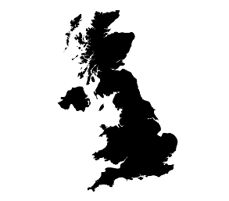



The impact of COVID-19 vaccine will not be instant; less than half of respondents plan to re-schedule their pre-COVID-19 trip immediately after a vaccine is found
Top 5 markets most likely to resume travel when a COVID-19 treatment is found
Intention to re-schedule a pre COVID-19 trip immediately after a treatment/ vaccine is found
Spain
61.8%
UK
Poland
48.4%
57.4%
France
Italy
43.3%
51.2%
11
Q6.To what extent do you agree/ disagree with the following statement: “when a treatment/ vaccine for COVID-19 is found, I will immediately book or reschedule the trip I had planned pre-COVID 19”
No. of respondents: 5,762

Slide 12



Optimism about travel remains with over half of respondents intending to take a trip, domestically or within Europe, in the next 6 months
Top 5 markets which are most likely
to travel in the next 6 months
Intention to travel in the next 6 months
Poland
74.2%
Germany
Italy
52.8%
57.8%
Austria
Spain
52.8%
54.4%
12
Q7.Do you plan to take an overnight trip domestically or within Europe in the next 6 months, either for personal or professional purposes?
No. of respondents: 5,762

Slide 13





All age groups – other than Gen Z (aged 18-24) – exhibit the same desire to travel in the next 6 months
18-24
By comparison with other age groups, Gen Z respondents (aged 18-24) seem the least likely to travel. Gen Zers prize fun and adventure in their travel experiences and for many destinations both of these elements are currently a challenge
25-34
35-44
45-54
>54
13
Q7.Do you plan to take an overnight trip domestically or within Europe in the next 6 months, either for personal or professional purposes?
No. of respondents: 5,762

Slide 14
“City life enthusiasts” (respondents that enjoy city breaks) are the most likely to resume travel first
Respondents most likely to travel in the next 6 months, per type of traveller
Sun & beach lovers
Bleisure travellers
Business travellers
Explorers of cultural identity & roots
Immersive explorers
City life enthusiasts
Gastronomy lovers
14
Q7.Do you plan to take an overnight trip domestically or within Europe in the next 6 months, either for personal or professional purposes?
No. of respondents: 3,086
No. of respondents: 5,762

Slide 15
More than 1 out 4 respondents intend to travel until November 2020 having either domestic or intra-European trips as top choices
When will Europeans travel next
Where will Europeans travel within the next 6 months
For specific dates please refer to slide 9
15
Q9.When are you most likely to go on your next trip either in your country or within Europe?
Q10.Where do you plan to travel in the next 6 months?
No. of respondents: 5,762
No. of respondents: 5,762

Slide 16
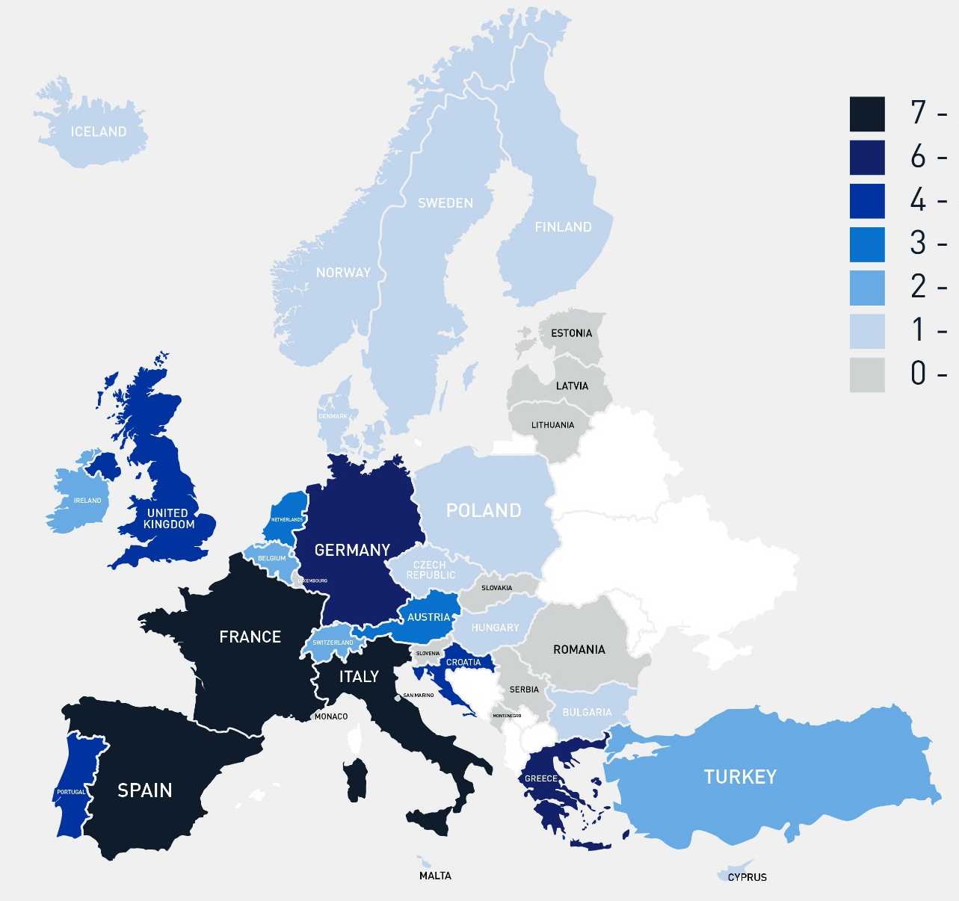

PREFERRED COUNTRIES FOR INTRA-ΕUROPEAN TRAVEL
Which countries respondents intend to visit next
TOP 10 COUNTRIES
Spain
France
Italy
Greece
Germany
Portugal
United Kingdom
Croatia
Austria
Netherlands
7.8%
7.3%
7.3%
6.2%
6.0%
4.6%
4.2%
4.1%
3.4%
3.3%
16
Q11. To which country(ies) do you plan to travel next?
No. of respondents: 3,915

Slide 17


Vacations only; respondents choose leisure and visiting friends and relatives for their next trip
Purpose of travel for respondents most likely to travel
in the next 6 months
Top 3 markets to resume
leisure travel
Top 3 markets to resume
business travel
Poland
Spain
50.2%
7.2%
Italy
Poland
43.3%
6.2%
Spain
Austria
35.2%
6.0%
17
Q8.For what reason are you most likely to travel within Europe next?
No. of respondents: 3,086

Slide 18

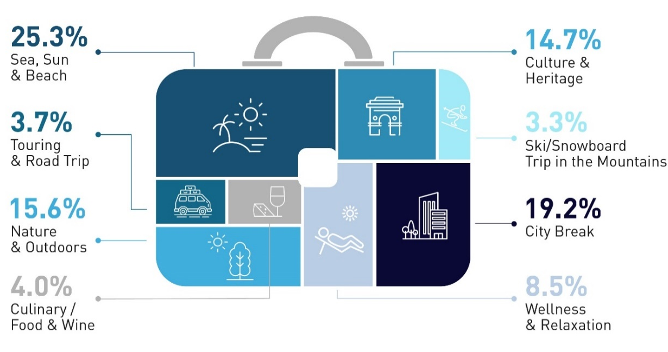


Respondents are still dreaming of their summer vacations with sea, sun and beach being on top of mind for their next holiday
The most popular destinations for sea, sun and beach are Spain, Italy and France
Preferred type of leisure trip for respondents most likely to travel
in the next 6 months
The most sought-after destinations for city break are Germany, France and Italy
The most preferred destinations for nature and outdoors are France, Italy and Germany
18
Q17.What type of leisure trip within Europe are you most likely to undertake next?
No. of respondents: 3,086

Slide 19





Sea, sun and beach is more popular among UK respondents, city breaks among respondents from Spain. Nature is top of mind among Germans while Italians favor culture the most
Sea, Sun, & Beach
City Break
Culture & Heritage
Nature & Outdoors
Cruising
19
Q17.What type of leisure trip within Europe are you most likely to undertake next?
No. of respondents: 5,762

Slide 20
GERMANY
More than 1 in 2 respondents intend to travel in the next 6 months having similar preference for domestic and European destinations
Willingness to travel in the next 6 months
When will Germans travel
Where will Germans travel within the next 6 months
No. of respondents: 750
No. of respondents: 750
No. of respondents: 750
For specific dates please refer to slide 9
20
Q7.Do you plan to take an overnight trip domestically or within Europe in the next 6 months, either for personal or professional purposes?
Q9.When are you most likely to go on your next trip either in your country or within Europe?
Q10.Where do you plan to travel in the next 6 months?

Slide 21
UNITED KINGDOM
More than 4 in 10 respondents are uncertain as to the timing of their next trip, while they show a stronger preference for domestic destinations
Willingness to travel in the next 6 months
When will British travel
Where will British travel within the next 6 months
No. of respondents: 750
No. of respondents: 750
No. of respondents: 750
For specific dates please refer to slide 9
21
Q7.Do you plan to take an overnight trip domestically or within Europe in the next 6 months, either for personal or professional purposes?
Q9.When are you most likely to go on your next trip either in your country or within Europe?
Q10.Where do you plan to travel in the next 6 months?

Slide 22
FRANCE
1 in 2 respondents intend to travel in the next 6 months, mostly in their own country
Willingness to travel in the next 6 months
When will French travel
Where will French travel within the next 6 months
No. of respondents: 750
No. of respondents: 750
No. of respondents: 750
For specific dates please refer to slide 9
22
Q7.Do you plan to take an overnight trip domestically or within Europe in the next 6 months, either for personal or professional purposes?
Q9.When are you most likely to go on your next trip either in your country or within Europe?
Q10.Where do you plan to travel in the next 6 months?

Slide 23

NETHERLANDS
More than 1 in 2 respondents intend to travel in the next 6 months and by a large majority will visit other European destinations
Willingness to travel in the next 6 months
When will Dutch travel
Where will Dutch travel within the next 6 months
No. of respondents: 477
No. of respondents: 477
No. of respondents: 477
For specific dates please refer to slide 9
23
Q7.Do you plan to take an overnight trip domestically or within Europe in the next 6 months, either for personal or professional purposes?
Q9.When are you most likely to go on your next trip either in your country or within Europe?
Q10.Where do you plan to travel in the next 6 months?

Slide 24
ITALY
Almost 6 in 10 respondents intend to travel in the next 6 months, by a vast majority inside their own country
Willingness to travel in the next 6 months
When will Italians travel
Where will Italians travel within the next 6 months
No. of respondents: 750
No. of respondents: 750
No. of respondents: 750
For specific dates please refer to slide 9
24
Q7.Do you plan to take an overnight trip domestically or within Europe in the next 6 months, either for personal or professional purposes?
Q9.When are you most likely to go on your next trip either in your country or within Europe?
Q10.Where do you plan to travel in the next 6 months?

Slide 25

BELGIUM
Almost 1 in 2 respondents intend to travel in the next 6 months, and the majority are eager to visit another European country
Willingness to travel in the next 6 months
When will Belgians travel
Where will Belgians travel within the next 6 months
No. of respondents: 500
No. of respondents: 500
No. of respondents: 500
For specific dates please refer to slide 9
25
Q7.Do you plan to take an overnight trip domestically or within Europe in the next 6 months, either for personal or professional purposes?
Q9.When are you most likely to go on your next trip either in your country or within Europe?
Q10.Where do you plan to travel in the next 6 months?

Slide 26

SWITZERLAND
Nearly 1 in 2 respondents intend to travel in the next 6 months and tend to be more confident with respect to the timing of the trips planned
Willingness to travel in the next 6 months
When will Swiss travel
Where will Swiss travel within the next 6 months
No. of respondents: 285
No. of respondents: 285
No. of respondents: 285
For specific dates please refer to slide 9
26
Q7.Do you plan to take an overnight trip domestically or within Europe in the next 6 months, either for personal or professional purposes?
Q9.When are you most likely to go on your next trip either in your country or within Europe?
Q10.Where do you plan to travel in the next 6 months?

Slide 27
SPAIN
More than 1 in 2 respondents intend to travel over the next 6 months, mainly favoring domestic destinations
Willingness to travel in the next 6 months
When will Spanish travel
Where will Spanish travel within the next 6 months
No. of respondents: 500
No. of respondents: 500
No. of respondents: 500
For specific dates please refer to slide 9
27
Q7.Do you plan to take an overnight trip domestically or within Europe in the next 6 months, either for personal or professional purposes?
Q9.When are you most likely to go on your next trip either in your country or within Europe?
Q10.Where do you plan to travel in the next 6 months?

Slide 28
POLAND
The most avid travellers with 3 in 4 of respondents intending to travel soon and with a strong desire for outbound travel
Willingness to travel in the next 6 months
When will Polish travel
Where will Polish travel within the next 6 months
No. of respondents: 500
No. of respondents: 500
No. of respondents: 500
For specific dates please refer to slide 9
28
Q7.Do you plan to take an overnight trip domestically or within Europe in the next 6 months, either for personal or professional purposes?
Q9.When are you most likely to go on your next trip either in your country or within Europe?
Q10.Where do you plan to travel in the next 6 months?

Slide 29
AUSTRIA
More than 1 in 2 respondents intend to travel in the next 6 months showing a similar preference for domestic and European destinations
Willingness to travel in the next 6 months
When will Austrians travel
Where will Austrians travel within the next 6 months
No. of respondents: 500
No. of respondents: 500
No. of respondents: 500
For specific dates please refer to slide 9
29
Q7.Do you plan to take an overnight trip domestically or within Europe in the next 6 months, either for personal or professional purposes?
Q9.When are you most likely to go on your next trip either in your country or within Europe?
Q10.Where do you plan to travel in the next 6 months?

Slide 30

TRIP PLANNING
02

Slide 31





The majority of respondents with short-term travel plans, intend to travel either with their partner or family
Preferred travel companion for respondents most likely to travel
in the next 6 months
With my family
Respondents between the ages of 35-54 are most likely to travel with their family, while respondents over the age of 55 with their partner
Other
Travelling with family (39%) or a partner (38%) is more common for domestic trips, while solo travel is strongly preferred (20%) among respondents who intend to visit destinations outside of Europe
With friends
With my partner
31
Q16.With whom are you most likely to travel during your next trip within Europe?
By myself
No. of respondents: 3,086

Slide 32

Travel review websites are the major source of information but hotels/ destinations’ digital assets and recommendations from friends are also taken into account
Preferred source of information for respondents most likely to travel
in the next 6 months
2 out of 3
respondents will rely on digital sources when planning their next trip
21.3%
12.1%
11.5%
11.0%
10.0%
7.9%
Travel review websites
A hotel’s website or social media
Recommendations from friends
Destination’s website or social media
Travel agent/ tour operator
An airline’s website or social media
32
Q12.What sources of information will you use the most when planning your next trip?
NB: Sampling carried out through online survey thus it may contain bias towards digital usage
No. of respondents: 3,086

Slide 33


Online booking through OTAs and search engines prevails
followed by direct bookings via accommodation/ airline websites
While digital booking is equally common among all age groups, the respondents over the age of 54 show a slightly higher preference for direct online booking
8.7%
Package holiday through
a Tour Operator
4.8%
Corporate travel office
12.6%
Travel agent/
travel designer
47.3%
Online booking engine
26.6%
Direct booking via
accommodation/ airline website
NB: Sampling carried out through online survey thus it may contain bias towards digital usage
33
Q13.How will you book your next trip within Europe?
No. of respondents: 3,086

Slide 34

While air flight remains the leading mode of transport, driving an owned car is not falling far behind
Top 5 markets which are most likely to travel by plane
in the next 6 months
Top 4 modes of transport for respondents most likely to travel
in the next 6 months
Spain
71.7%
France
UK
56.6%
67.0%
Poland
Italy
52.6%
61.2%
34
Q14.Which of the following modes of transport would you most consider using during your next trip within Europe?
No. of respondents: 3,086

Slide 35


Hotel or resort chains are the top choice of accommodation
Preferred type of accommodation for respondents most likely to travel in the next 6 months
Other paid serviced accommodation (i.e. bed and breakfast, parador, etc.)
Camping/caravan
Other
Hotel chain or resort
Respondents from Spain, Austria, UK and Italy are the most likely to stay at a hotel or a resort (chain/ independent)
Short-term rental via online platform
Hostel/motel
Camping and caravan travel are most popular among respondents from the Netherlands, Belgium and Germany
Friends and/or family
Independent hotel/resort
35
Q15.Which of the following types of accommodation would you most consider staying at during your next trip within Europe?
No. of respondents: 3,086

Slide 36
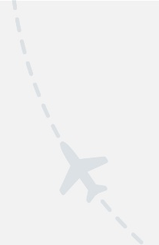
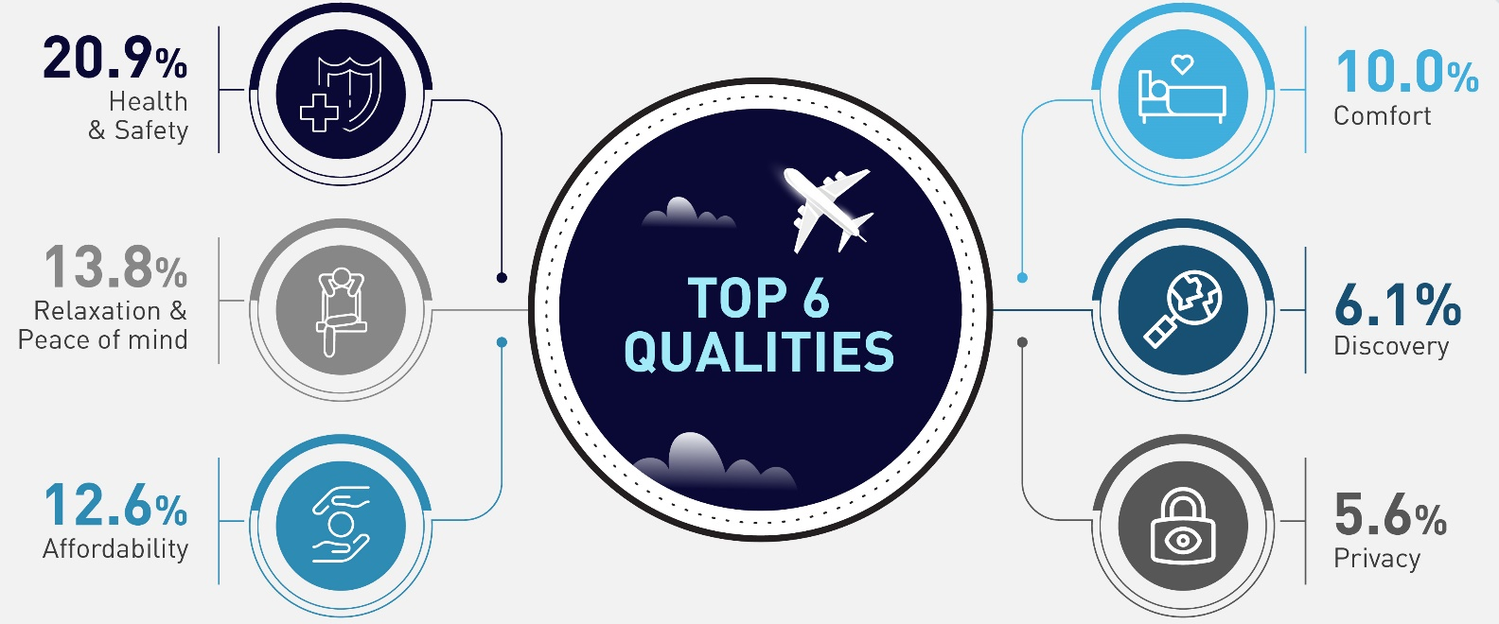
Health and safety are by far the most important travel qualities
while peace of mind, relaxation and affordability are also rated highly
The term “Travel Qualities” refers to the nature, traits and characteristics of the travel experience sought by consumers.
36
Q19.Which of the following qualities regarding travel are more important to you now compared to last year?
No. of respondents: 5,762

Slide 37
TRAVEL CONCERNS
03

Slide 38
Is COVID-19 truly a trip killer? While a majority of respondents cancelled their short-term travel plans, a significant portion either rescheduled or pivoted trips to domestic destinations
Top 5 markets which chose a domestic trip over international
How has COVID-19 affected travel plans
Austria
26.2%
Respondents aged 35-44 are the most resilient age group, taking their initial trip or making only a few changes
Poland
22.0%
Italy
20.0%
Spain
19.8%
Germany
19.1%
38
Q2.If you had planned an overnight trip in the next 6 months within Europe, how does COVID-19 affect your plans?
No. of respondents: 5,762

Slide 39






Finding a vaccine for COVID-19 tops the list of factors in travel decision – making, followed very closely by flexible cancellation policies and the complete lifting in travel/ quarantine restrictions
Finding a vaccine
10.1%
Flexible cancellation policies
9.9%
In an era of uncertainty, flexible cancellations policies are a priority for encouraging consumers to book and much more important than offers and deals.
Fully lifted travel restrictions
9.6%
Pre-flight rapid COVID-19 tests
9.3%
Especially among respondents more eager to travel in the next 6 months, flexibility in cancellation is the single most important factor (10.6%), followed by social distancing in flights/ public transport (9.2%) and only then followed by finding a vaccine (8.8%) and fully lifted travel restrictions (8.8%)
Social distancing on flights/public transport
9.3%
Destinations’ effectiveness managing COVID-19
8.5%
39
Q3.Which factors are currently most important to you when travelling within Europe?
No. of respondents: 5,762

Slide 40
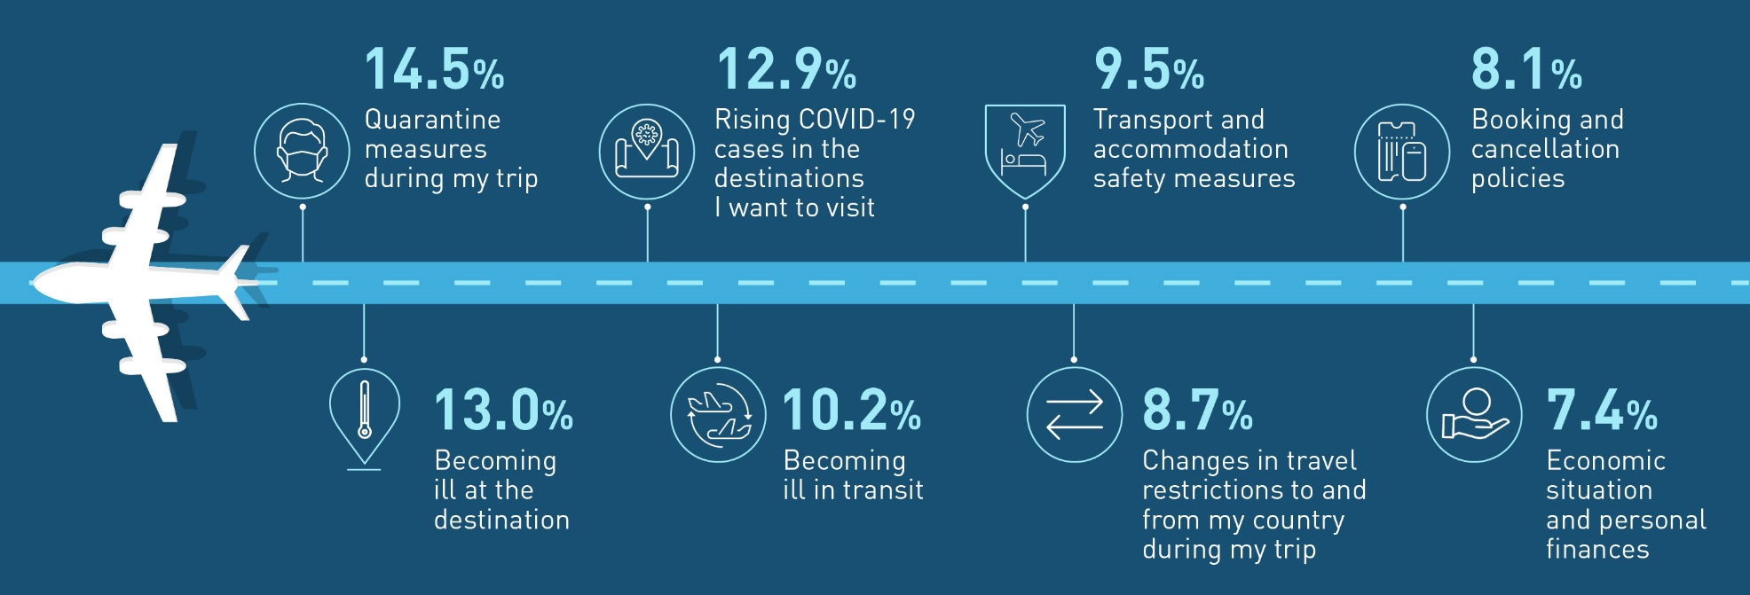
SIZING UP TRAVEL ANXIETIES
While quarantine measures is the major issue impacting choices about travelling, health concerns at the destination also figure prominently
40
Q4.What currently concerns you the most about travelling within Europe?
No. of respondents: 5,762

Slide 41
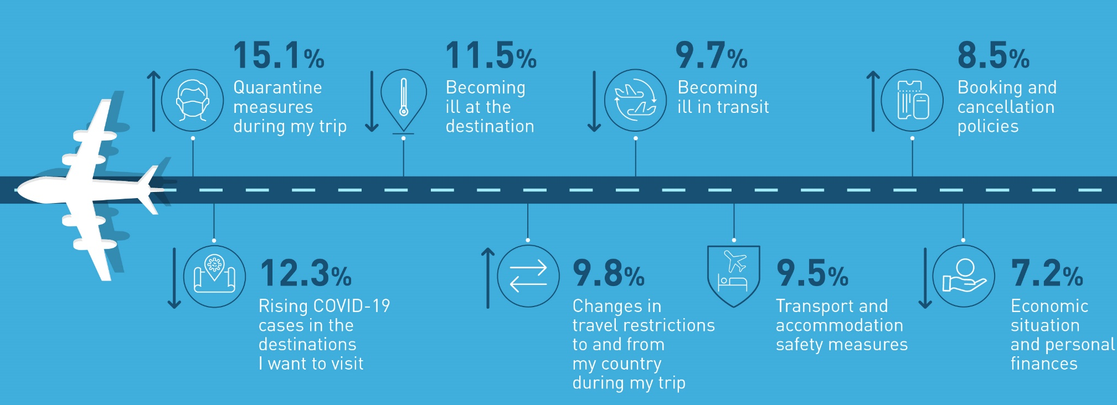
TRAVEL CONCERNS OF “EARLY BIRD” TRAVELLERS
Bureaucratic/ administrative processes (i.e. quarantine, changes in travel restrictions, booking & cancellation policies) pose a greater concern for respondents with short-term travel plans
41
Q4.What currently concerns you the most about travelling within Europe?
No. of respondents: 3,086

Slide 42





By a wide margin, air travel is considered the least safe part of a trip, healthwise
Top 5 touch points of concern during travel
in relation to personal health & safety
Concern regarding air travel increases with age: 51.2% of respondents aged 54+ are concerned by air travel, versus 39.5% in the 18-24 age group
In-destination transport (i.e. metro, bus, taxi), attractions, tours and activities as well as public spaces and accommodation are also considered important
42
Q5.In relation to your personal health and safety, which parts of your journey will concern you the most?
No. of respondents: 5,762

Slide 43



THE UNCERTAINTY CONTROL PANEL
4 KPIS SHOWCASE THE LEVEL OF UNCERTAINTY FOR DOMESTIC AND INTRA-EUROPEAN TRAVEL
The tourism industry has been impacted by high uncertainty regarding travellers’ intentions and preferences as well as the ability for cross border travel. As the sector will move towards recovery, values of these KPI’s are expected to lower
9.9% of respondents state that they consider flexible cancellation policies as an important factor when travelling
8.1% of respondents state that they consider booking and cancellation policies, a major concern about travelling
32.4% of respondents state that they do now know when they intend to go on their next trip
10.4% of respondents state that they do now know where they intend to travel in the next 6 months
43
9.9%
8.1%
32.4%
10.4%
No. of respondents: 5,762

Slide 44
METHODOLOGICAL ANNEX
04

Slide 45
METHODOLOGICAL ANNEX
THE SURVEY
Online market research survey
Distribution/ data collection period: 27 August 2020 - 15 September 2020
Consumers with at least 2 overnight trips in 2019 participated in the survey
5,762 respondents in total, from 10 high-volume source markets
Countries: Germany, United Kingdom, France, Netherlands, Italy, Belgium, Switzerland, Spain, Poland and Austria
Languages: English, French, German, Italian, Spanish, Polish and Dutch.
Research themes examined: Travel personas (1 question), Travel concerns and COVID-19 impact on travel (6 questions), Travel intentions, preferences and trip planning (10 questions), COVID-19 and responsible travel (3 questions)
51% of respondents are male and 49% are female
Number of respondents and age group per source country:
 |  | Country |  |  |  |  |  |  |  |  |  | Total
 |  | UK | IT | ES | AT | FR | DE | PL | BE | CH | NL
Age | 18 - 24 | 88 | 73 | 45 | 74 | 96 | 100 | 75 | 183 | 92 | 145 | 971
 | 25 - 34 | 135 | 112 | 74 | 133 | 129 | 167 | 131 | 130 | 71 | 140 | 1,222
 | 35 - 44 | 126 | 135 | 101 | 143 | 141 | 161 | 132 | 87 | 53 | 110 | 1,189
 | 45 - 54 | 138 | 167 | 105 | 98 | 146 | 168 | 96 | 77 | 41 | 58 | 1,094
 | >54 | 263 | 263 | 175 | 52 | 238 | 154 | 66 | 23 | 28 | 24 | 1,286
Total |  | 750 | 750 | 500 | 500 | 750 | 750 | 500 | 500 | 285 | 477 | 5,762
45

Slide 46
Copyright © 2020 European Travel Commission (ETC)
This project is co-funded by the European Union
Study on Monitoring Sentiment for Intra-European Travel
All rights reserved. The contents of this report may be
quoted, provided the source is given accurately and
clearly. Distribution or reproduction in full is permitted for
own or internal use only.
While we encourage distribution via publicly accessible
websites, this should be done via a link to ETC’s
corporate website, www.etc-corporate.org
Data sources: This report is based on research conducted
by MINDHAUS (www.mindhaus.gr) and should be interpreted by users according to their needs.
Please note that while every possible effort has been made to ensure the data in this report is accurate, it is not possible to completely eliminate every margin of error.
Published by the European Travel Commission
Rue du Marché aux Herbes, 61,
1000 Brussels, Belgium
Website: www.etc-corporate.org
Email: info@visiteurope.com
ISBN No: 978-92-95107-38-0
Design: MINDHAUS
Image ID: 1204292545 Copyright: KONGSTOCK/Shutterstock
Co-funded by the European Union

